Slide 1
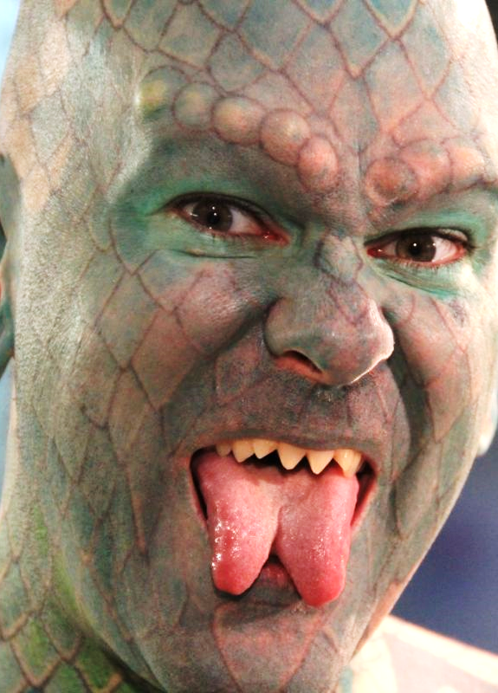

The Wild, Wonderful World of Oral Path
The Abused Mouth
Oral Effects of Uses & Abuses
------
A Chronicle of Mouth Changes from Drugs, Products, Habits
First Abuses? Phossy Jaw, Radium Jaw
Tobacco, Vaping, Marijuana Smoking
Methamphetamines
Cocaine/Crack
Bulimia & Tooth-Damaging Habits
Mouth Jewelry, Tattoos & “Surgery”
Side Effects of Dental Products & Rx
Side Effects of Prescription Drug
Allergies to Stuff
J. E. Bouquot, DDS, MSD, DABOMP, DABOM
Director of Research, The MFCenter for Education & Research, Morgantown, WV
Emeritus Professor & Past Chair, University of Texas, Houston
Clinical Professor & Past Chair, West Virginia University
Start of Seminar
BouquotToGo Dropbox Files
Bouquot
Dedication
Copyright

Slide 2


Lectures By Bouquot
© Dr. J.E. Bouquot, Morgantown, WV
© Copyright Notice
Lecture Aids/Handouts
This presentation is, essentially, the modern version of a handout. It is intended for participants attending lectures/courses given by the author. Designated owners of the photographic images retain the copyrights for those images. You are welcome to use this presentation for your own study or study with other health professionals. However, permission is NOT given for the publication of these photos in electronic or any other format for profit or for public viewing.
Note: Dr. Bouquot is affiliated with West Virginia University & the University of Texas. While every attempt has been made to be accurate, the information and ideas in this presentation are not necessarily the views of these institutions.
Contact: bouquot@aol.com

Slide 3
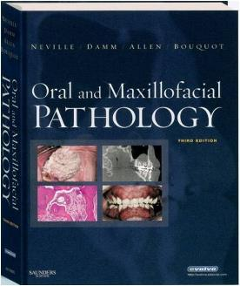
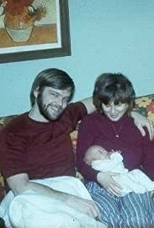
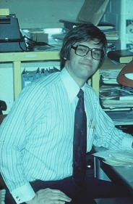
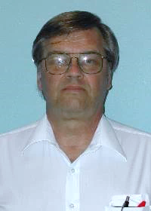

J. E. Bouquot, DDS, MSD, DABOMP, DABOM(Honorary), FAAOMP, FICD, FACD, FADI, FRSM(UK)
Director of Research, The Maxillofacial Center for Education & Research, Morgantown, West Virginia
Clinical Professor & Past Chair, West Virginia University , Morgantown, West Virginia
Emeritus Professor & Past Chair, University of Texas, Houston, Texas
Page 1 of 2
1,880+ talks in 50 states & 30 countries…440+ publications…19,700+ citations
St. Olaf College, Minnesota (BA in psychology, biology, minor in chemistry)
University of Minnesota (DDS, MSD in Oral Pathology, under R. J. Gorlin)
Mayo Clinic: Bone Pathology Fellowship (under David Dahlin)
Royal College Dent., Copenhagen, Denmark: Oral Path Fellowship (under J. J. Pindborg)
Chair (18 yrs), Oral & Maxillofacial Pathology, WVU (youngest OMP Chair in US history)
Chair (9 yrs), Diagnostic & Biomedical Sciences, University of Texas-Houston
Senior Visiting Scientist, Mayo Clinic, Rochester, Minnesota
Dental Director, West Virginia Bureau for Public Health
Consultant, Pittsburgh Children’s Hospital; NY Eye and Ear Infirmary
Osteonecrosis Scientific Advisory Board, Novartis Pharmaceuticals
Board of Directors (national), American Cancer Society
Executive Council, American Academy of Oral & Maxillofacial Pathology
President, American Board of Oral & Maxillofacial Pathology
President, Eastern Society of Teachers of Oral Pathology
President, Western Society of Teachers of Oral Pathology
President, Organization of Teachers of Oral Diagnosis
President (6 times), American Cancer Society, West Virginia Division
Career Development Award, American Cancer Society (first dentist to receive one)
St. George National Award, American Cancer Society’s highest honor
Outstanding Teacher Award, West Virginia University (8 times)
Heebink Award for Service to Humanity, West Virginia University
Scholar’s Walk (Two bronze plaques), West Virginia University
Robert B. Bridgeman Distinguished Dentist Award, WV Dental Association
Fleming & Davenport Award for Original Research, University of Texas-Houston
Pioneering Teaching & Research Award, University of Texas-Houston
Distinguished Alumnus Award, University of Minnesota
Gorlin Visiting Professor, University of Minnesota
Honorary Life Member, International Association of Oral Pathologists’ highest award
Honorary Diplomate, American Academy of Oral Medicine (1st OMP to receive it)
Honorary Member, Mexican Assoc. of Oral Path & Oral Med. (1st American to receive)
Age 28
Age 35
Age 49
Elmer Bouquot, age 78,
J. Elmer Bouquot, age 56
Age 67

Slide 4
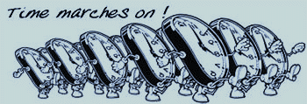

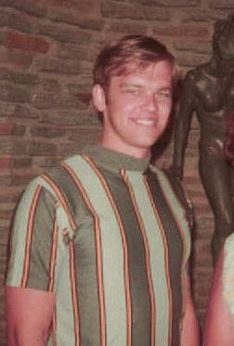
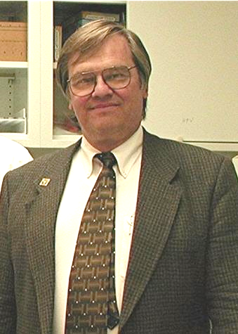
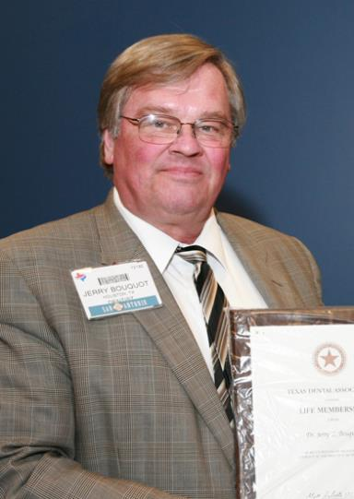

This is What Dentistry will Do to You!
Page 2 of 2
In Middle School, age 15
In Oral Pathology
Residency, age 25
In Private OMP
Practice, age 58
In 27th Yr. as Dept.
Chair, age 69
In 8th Yr. of
Doing Nothin’, age 78
Ages 0-14, Minnesota
Ages 19-28, Minnesota
Ages 31-59, West Virginia
Ages 70-78, West Virginia
Ages 15-18, New Jersey
Ages 29-30, Denmark
Ages 60-69, Texas

Slide 5

The BouquotToGo Files,
Including “The 53 Most Common Oral Lesions”
Dropbox Files of Dozens of Power Point Modules with >3,600 Copyright-Free Photos
BouquotToGo * – Filled with copyright-free files (>3,600 photos, mostly clinical). You may use these files & photos as you wish, including giving them or the link to colleagues, putting them on your own public website, etc. Click below or cut and paste into your browser window, then download via the triple dots (…) menu in upper right:
https://www.dro pbox.com/sh/umu7o3jce1p5vz6/AABhfYreRJu165xBU1yKUdzta?dl=0
Initially available in 1992 on CD , then on DVD, then in a Dropbox folder (since 2003).
Continuously updated, upgraded and added to.
The 53 Most Common Oral Lesions – A hyperlinked Power Point module of the most common oral lesions (excluding caries & periodontitis) found in ~25,000 U.S. adults. Over 500 clinical photos review these lesions, grouping them by clinical appearance and also listing them by prevalence. Click below or cut and paste into your browser window, then download via the triple dots (…) menu in upper right:
https://www.dropbox.com/s/c4u3kmmfgvdv7kl/53_Most_Common_Oral_Lesions.pptx?dl=0

Slide 6
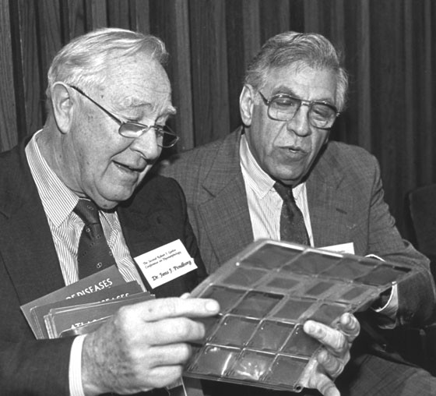
This presentation is dedicated to Dr. Bouquot’s prime mentors, both from the first generation of Oral & Maxillofacial Pathologists, both premier experts in teaching, clinical research and the diagnostic arts
Dr. Robert Gorlin, Minneapolis, Minnesota (right)
Dr. Jens Pindborg, Copenhagen, Denmark (left)
Dedication

Slide 7
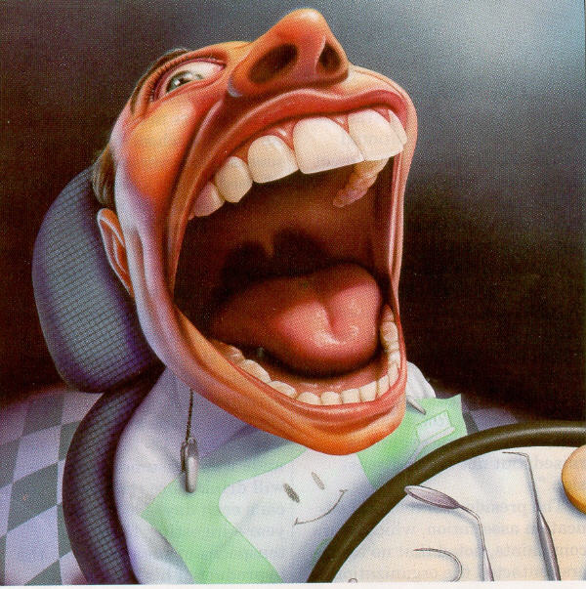
Start of Seminar

Slide 8
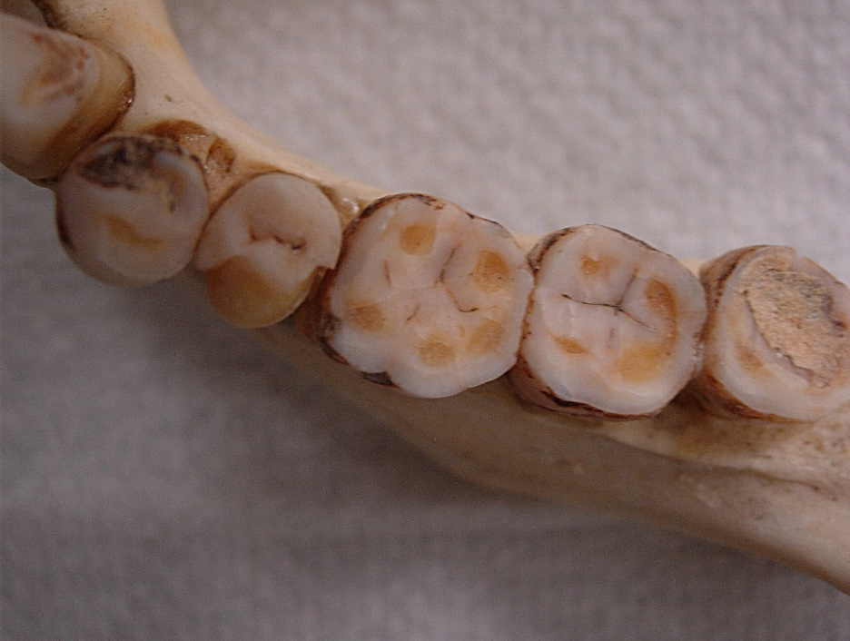
First Abuses?
Phossy Jaw, Radium Jaw
Actually, the first abuse probably started with farming, 12,000 years ago:
severe, generalized abrasion from chewing lots of grains, with dust

Slide 9
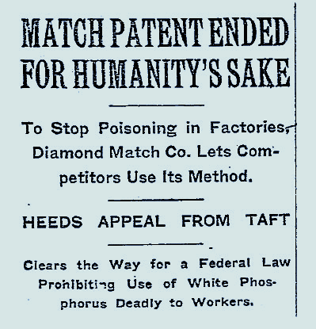
Phossy Jaw
Ranks 9th amongst the 10 deadliest occupations in recent history
1888 strike by the “London matchgirls” was first grass-roots public health protest
William Howard Taft: 27th US President,1909-1913

Slide 10
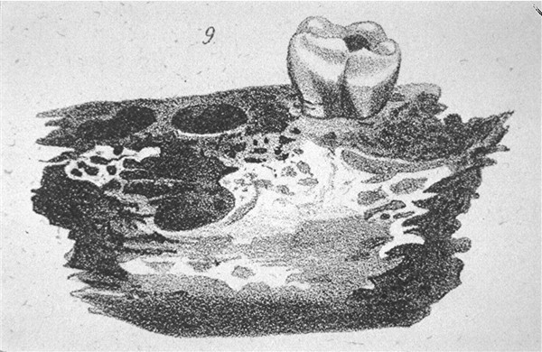
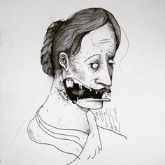
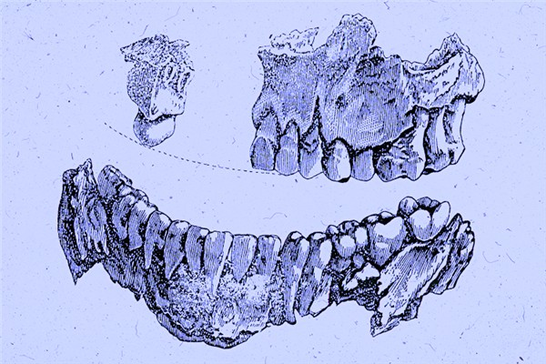
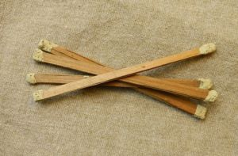
Phossy Jaw
Phosphorus Necrosis of Jaws; Phosphorimus Chronicus
Started in 1830s, when “safety” matches were invented, used white phosphorus (more toxic than red phosphorus)….first case = in Vienna
Bone death and sequestration from phosphorus poisoning
Patient sought dental help because of pain:
mistaken for toothache; maybe exposed bone
Called: bone caries, chemical osteomyelitis,
phossy jaw
No pus, erythema, edema of soft tissues
Dead bone fragments broke off when dentist
attempted extraction(s)
-- Entire alveolus may slough off
DDSs then knew it was not osteomyelitis
Quite using white phosphorus in 1890s
Phosphorus: converted into bisphosphonate
by inflammatory mediators, cytokins, etc.

Slide 11
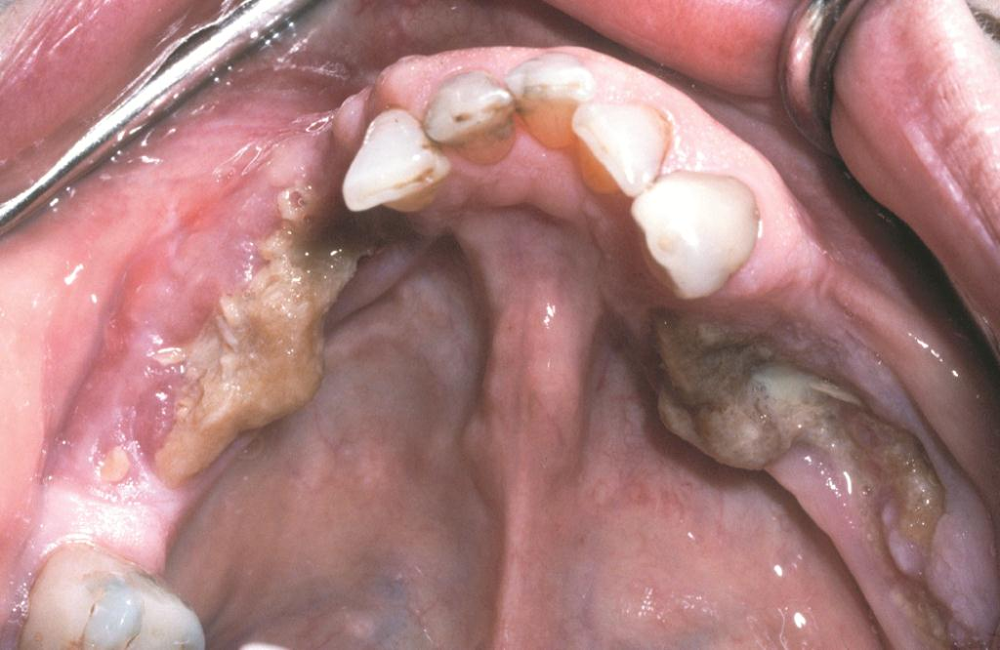
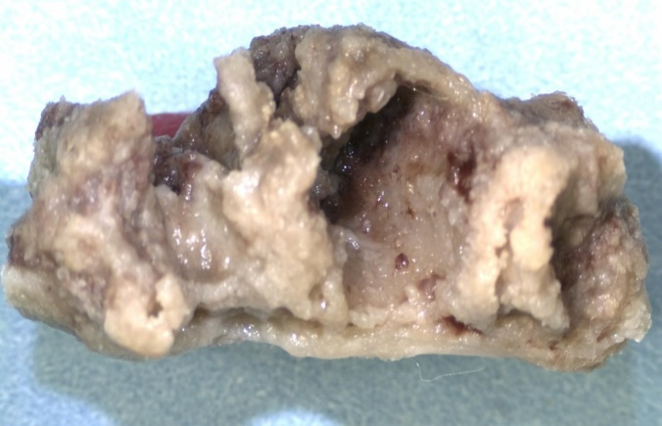
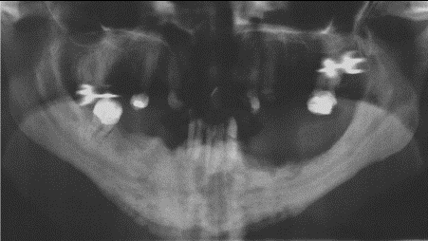
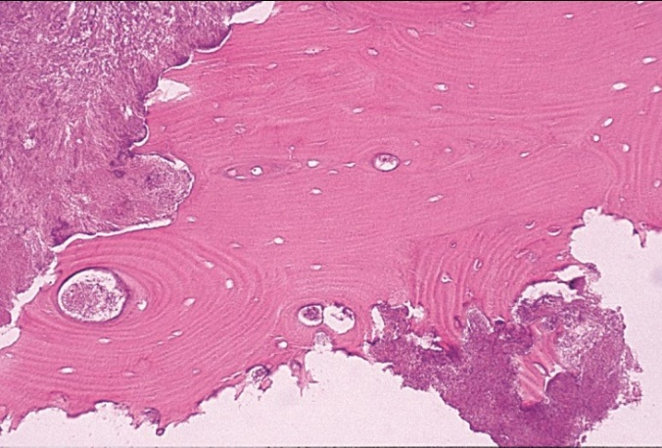
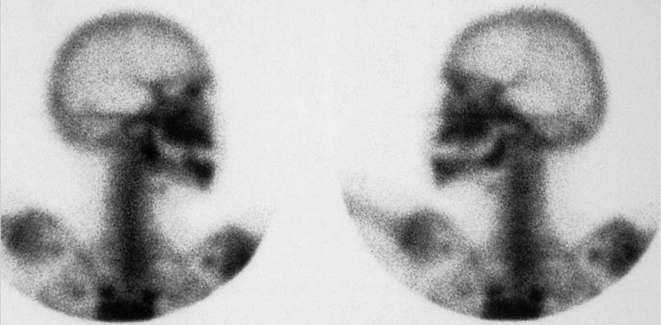
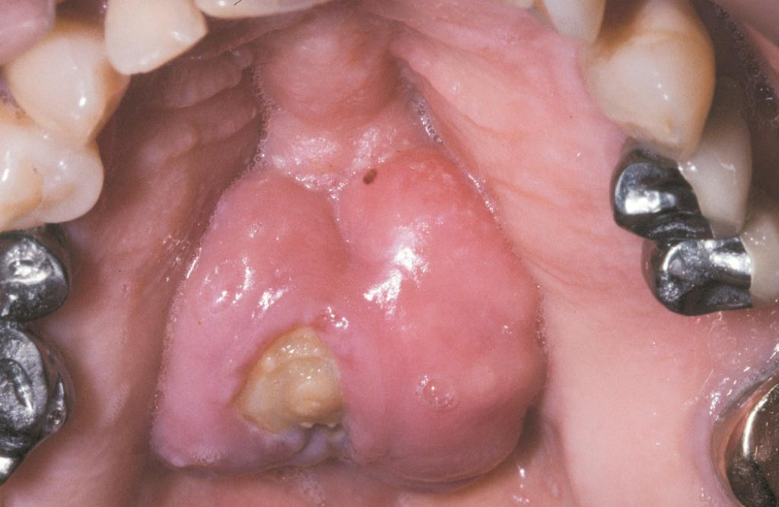
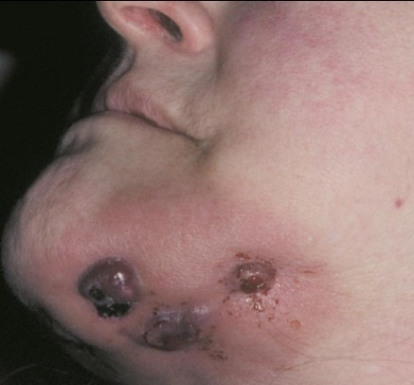
Bisphosphonate-Associated Osteonecrosis
BONJ, BRONJ, MRONJ
Exposed mandibular bone
From long-term use of bisphosphonates
-- Cancer meds (Zometa, Aredia) for metastasis (risk = 6-10%;
highest risk: multiple myeloma
-- Osteoporosis meds (Fosamax, etc.); risk = 1:14,000 – 1:100,000
Antiresorptive and antiangiogenic agents,
i.e. monoclonal antibodies targeting vascular
endothelial growth factor (VEGF) receptors
-- Denosumab inhibits RANKL, RANKL is needed to
activate osteoclasts *
Special problem with Vit D deficiency?
Alveolar sequestration,
started with RCT
Same patient as above
* receptor activator of nuclear factor kB (RANK)-RANK ligand (RANKL)
Bony sequestrum covered by bacteria

Slide 12
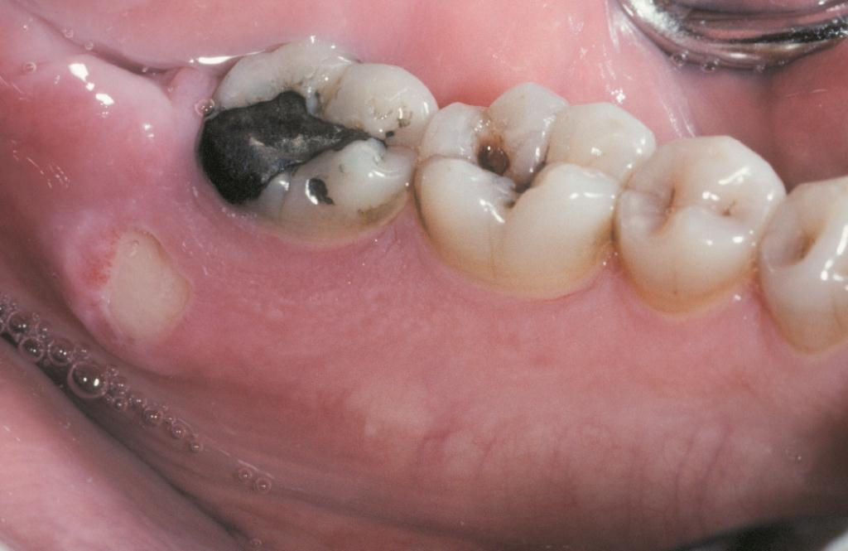
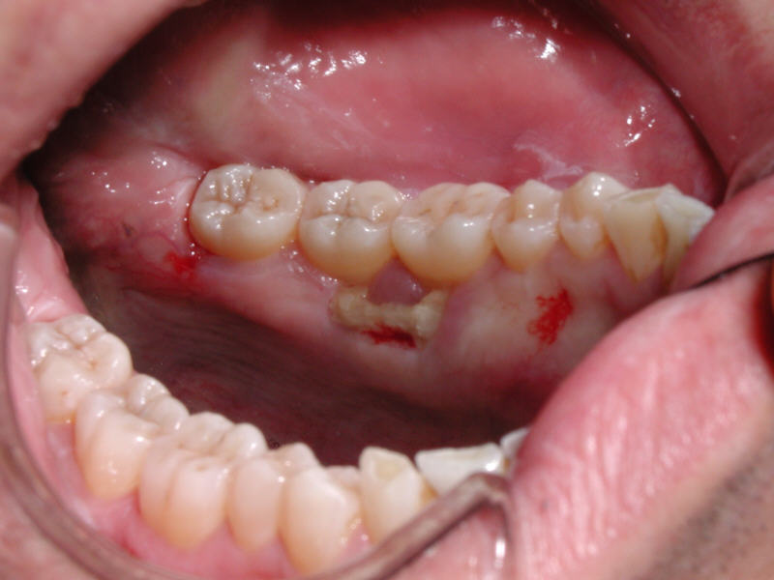
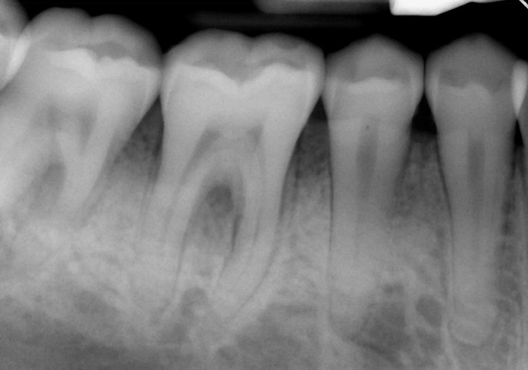
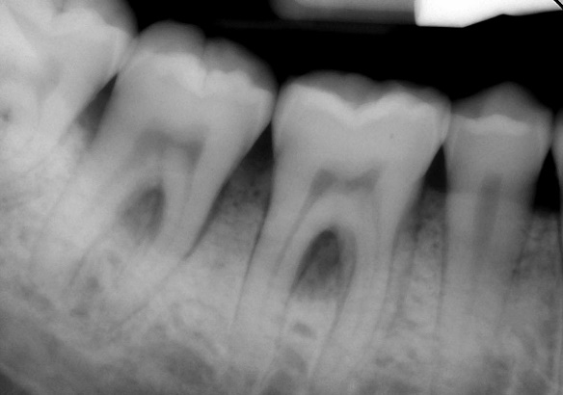
Bisphosphonate-like Osteonecrosis
Spontaneous Sequestration
Bone exposure and sloughing without use of bisphosphonates
No obvious cause, but seems ischemic
Starts: pain, maybe underlying radiolucency
Then: more pain, sloughed cortex (sequestrum)
Heals spontaneously; no problems thereafter
Almost always on lingual of mandible
Maybe on torus mandibularis
Check for Vitamin D deficiency?
Exposed bone of lingual cortex; minimal inflammation of surrounding soft tissues

Slide 13
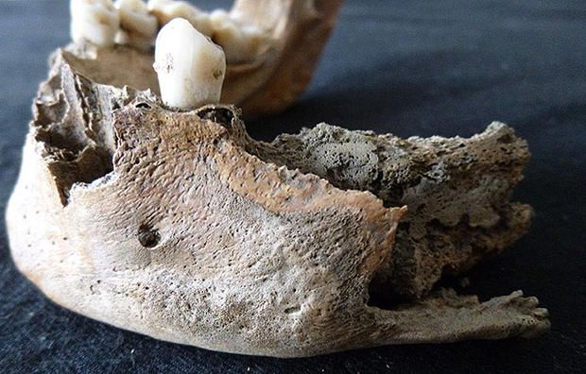
Radium Jaw
Ranks 8th amongst the 10 deadliest occupations in recent history

Slide 14
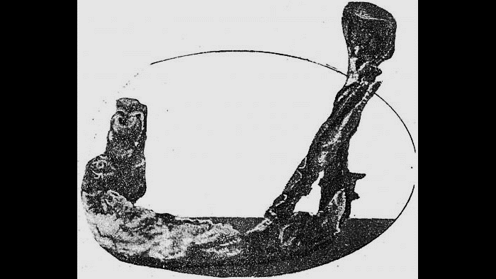
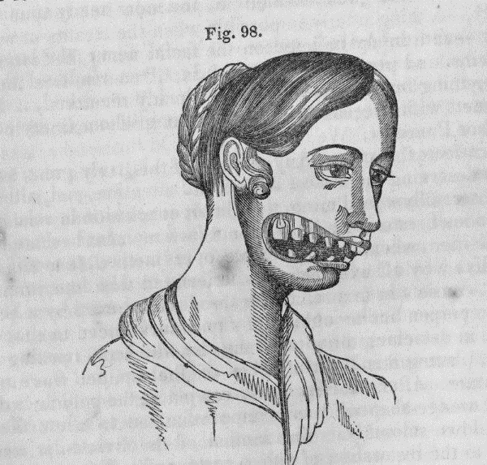
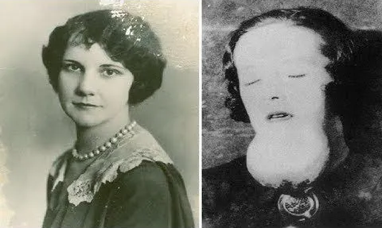
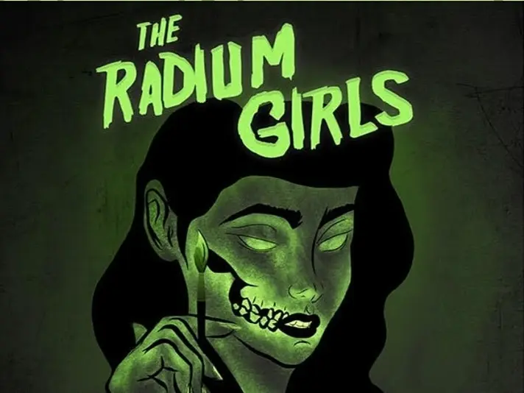
Radium Jaw
Radium was used to paint “glow-in-the-dark” watches; workers wetted paint brush continuously throughout the day
Jawbone becomes honeycombed, brittle, exposed bone after extraction
First report: 1924, NY dentist, Theodor Blum, called it "radium jaw“
Almost all were girls/women factory workers, some were male miners
Clinically similar to BRONJ, osteoradionecrosis
The workers would wear their factory dresses on dates…they glowed at night
2018 film

Slide 15
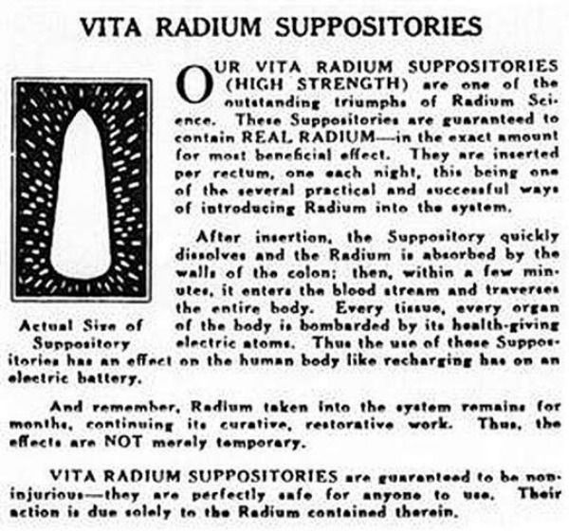
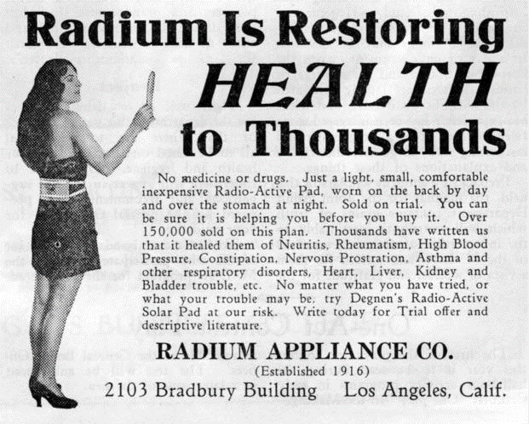
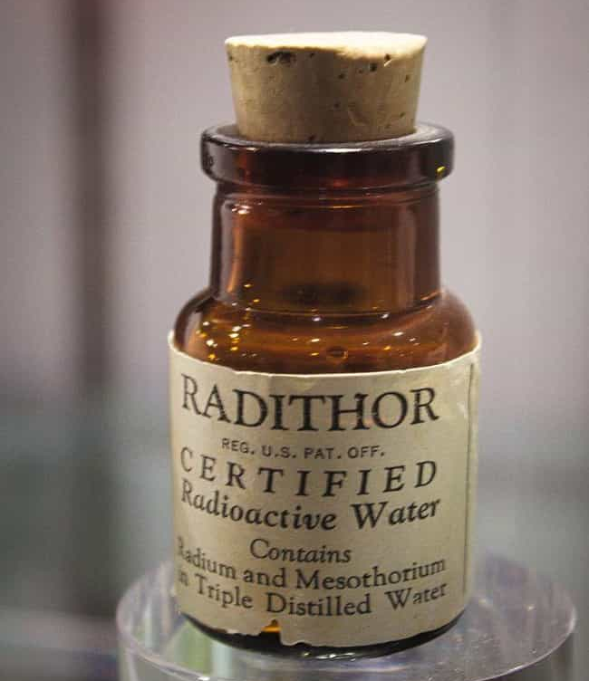
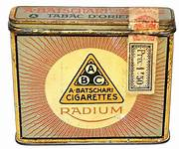
Radium was Sold as a Healing Therapy

Slide 16
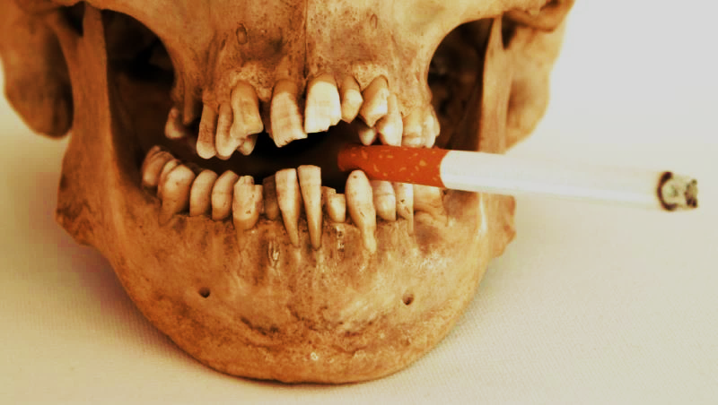
Tobacco, Vaping,
Marijuana Use

Slide 17
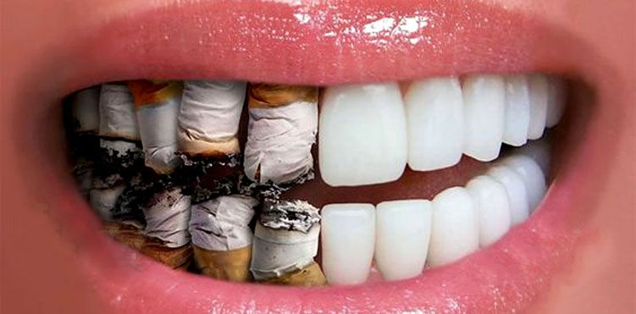
Tobacco Smoking
R. J. Reynolds started producing cigarettes in factories in 1911 as a health benefit
He was trying to reduce TB spread by spitting smokeless tobacco juice everywhere

Slide 18
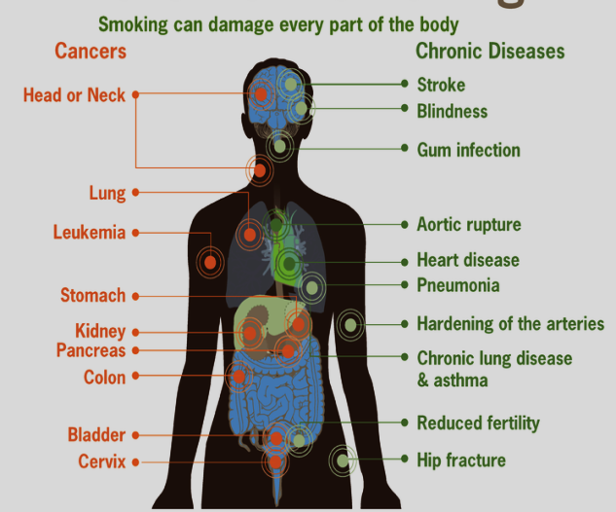
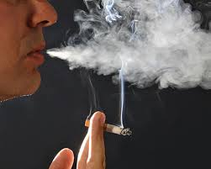
Effects of Tobacco Smoking
Vaping
Nicotine: ↑ vasoconstriction, ↑ bp, ↑ coagulation, ↑ heart rate, ↑ dopamine (addiction)
↑ adrenalin, ↓ insulin; ↑ tolerance, ↑ sedative effect

Slide 19
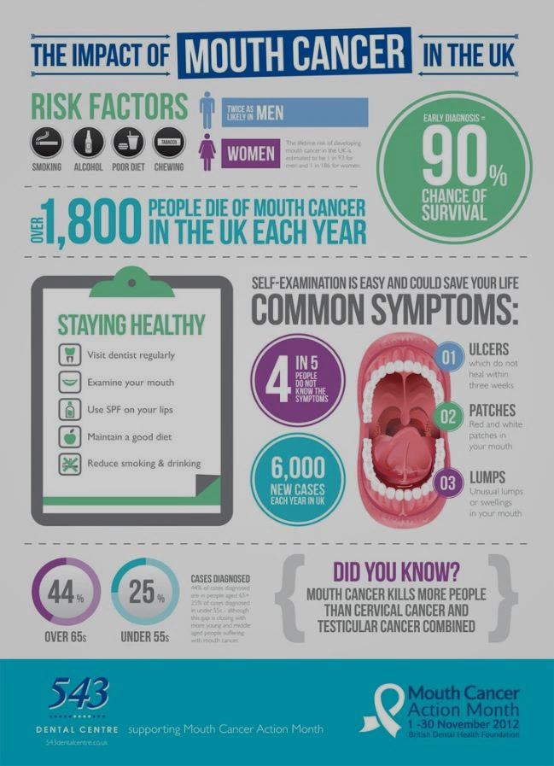
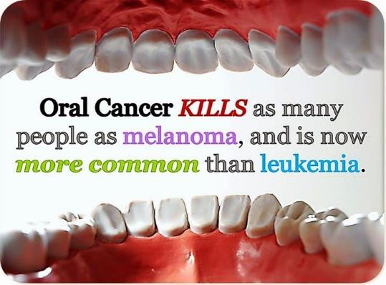
Squamous Cell Carcinoma
Oral Cancer Risk
In approximately one of every three Americans now living, a malignancy will develop at some point. During 2000, more than 1,220,000 persons in the United States had at least one malignancy, in addition to an equal number with nonmelanoma skin cancers. Although 54% of affected persons now survive their disease, cancer still causes 552,200 deaths each year in the United States and accounts for more than 20% of all deaths. Also, the current annual death rate from nondermal cancers (170 per 100,000 persons) has increased by 19% since 1930, partially because of a considerable increase in the incidence of lung cancer and partially because people are now less likely to die at an early age of other common disorders, such as cardiovascular disease and infection. During the 1990s, however, this trend was reversed, and the average annual incidence and mortality rates for all cancers combined (excluding nonmelanoma skin cancers) began to decline.
Risk increase with age
Risk increases for white males, slowly decreasing since 1980s
--Problem: black male risk: ↑↑
In other countries: intraoral cancer continues to ↑ slowly for all races
Females (white or nonwhite): ↓↓↓ incidence than ♂ (male:female ratio = 3:1)
Used to be a wider difference, but now more women smoke

Slide 21
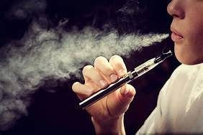
Vaping
R. J. Reynolds started producing cigarettes in factories in 1911 as a health benefit
He was trying to reduce TB spread by spitting smokeless tobacco juice everywhere

Slide 22
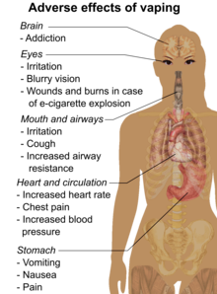
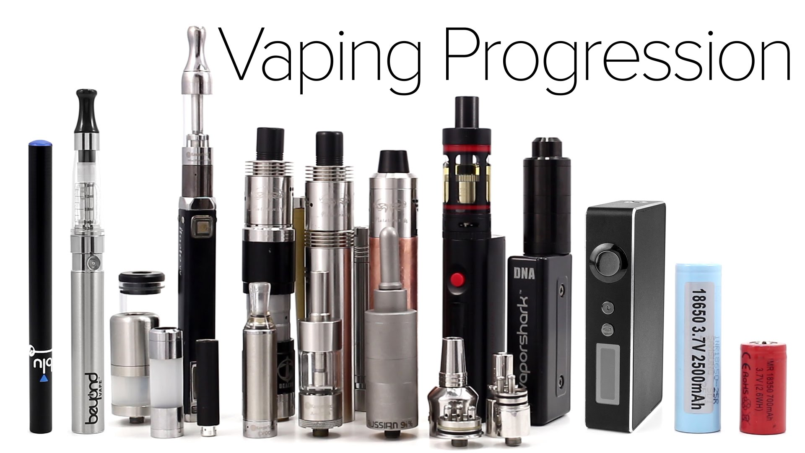
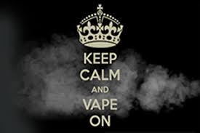
Vaping – Adverse Effects?
Vapes, vaporizers, vape pens, hookah pens, electronic cigarettes,e-cigarettes , e-cigs), e-pipes, ENDS (Electronic Nicotine Delivery System), JUULs
E-cigarette = the device; vaping = the inhaling activity
>4,000,000 high school users now
Same level of nicotine as cigarettes
Lower level of toxins, but still Inhaling ultrafine particles
-- <1% of approved industrial levels for cigarettes
FDA regulated inhalers: safer than e-cigs
Reduces lung & myocardial function, increase inflammation, have toxic content including carcinogens, ↓↓ than cigarettes
>2,100 explosions, burns, eye damage, etc.

Slide 23
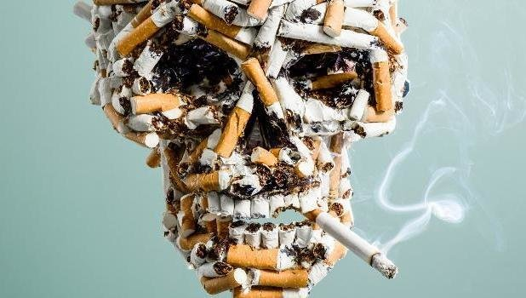
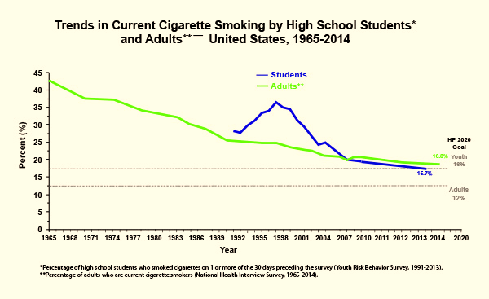
Tobacco’s Sad Effects
Half of all Americans who keep smoking will die because of the habit
-- 16% of US adults smoke, but they are the heavy smokers usually
480,000 people/year in U.S. die from illnesses related to tobacco use
-- Men and women have almost equal risk
Each year smoking causes about 1 out of 5 deaths in the US
Smoking cigarettes kills more Americans than alcohol, car accidents, HIV, guns, and illegal drugs combined
Smoking shortens lives: for males = 12 years; females = 11 years
Smoking can damage nearly every organ in the body, including the mouth

Slide 24
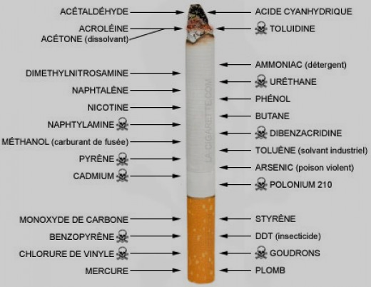


Major Causes Of Oral Cancer
Tobacco & Alcohol
Cause = multifactorial (extrinsic & intrinsic factors)
Field cancerization (entire H&N mucosae are exposed)
Multi-step process (cocarcinogenesis)
Synergism (alcohol + tobacco = worse together)
Tobacco smoking/chewing
-- Pipe/cigar smoking>cigarettes>>>>>smokeless
-- Dose-, duration-dependent:↑ risk > 2ppk = 15x
Alcohol abuse
Human papillomavirus
Tertiary syphilis (syphilitic glossitis/leukoplakia)
Sunlight/UV light (for vermilion cancer only)
Iron-deficiency anemia (posterior 1/3 of tongue
-- Plummer-Vinson (Paterson-Kelly) syndrome
General malnutrition
Heredity = not a major factor
Mutations of p53, other tumor suppressor genes
Phenols (wood workers)
Irradiation in childhood

Slide 25




Oral Cancer = 90% SCC
Oral Cancer: One of the H&N Cancers
In approximately one of every three Americans now living, a malignancy will develop at some point. During 2000, more than 1,220,000 persons in the United States had at least one malignancy, in addition to an equal number with nonmelanoma skin cancers. Although 54% of affected persons now survive their disease, cancer still causes 552,200 deaths each year in the United States and accounts for more than 20% of all deaths. Also, the current annual death rate from nondermal cancers (170 per 100,000 persons) has increased by 19% since 1930, partially because of a considerable increase in the incidence of lung cancer and partially because people are now less likely to die at an early age of other common disorders, such as cardiovascular disease and infection. During the 1990s, however, this trend was reversed, and the average annual incidence and mortality rates for all cancers combined (excluding nonmelanoma skin cancers) began to decline.
Oral cancer = 3% of all cancers in US; 6th most common in males, 12th in females
-- 21,000 new cases annually
-- 6,000 deaths annually
25th most common oral mucosal lesion
Prevalence = 1/1,000 adults
In India: oral = the most common cancer
Fungating squamous cell carcinomas

Slide 26

The 53 Most Common Oral Lesions
Based on examination of ~25,000 adults
Diagnosis (* = Precancer or Cancer) | Rank | Prevalence per 1,000
Herpes labialis | 16 | 2.5
Mucocele | 17 | 2.4
Scar tissue | 18 | 2.1
Angular cheilitis | 19 | 1.9
Smokeless tobacco keratosis * | 20 | 1.7
Lingual tonsil, hyperplastic | 21 | 1.6
Hemorrhage, submucosal | 22 | 1.5
Frictional keratosis (cheek bite) | 23 | 1.1
Lichen planus | 24 | 1.1
Squamous cell carcinoma | 25 | 0.9
Buccal exostosis | 26 | 0.9
Amalgam tattoo | 27 | 0.8
Median rhomboid glossitis | 28 | 0.6
Hairy tongue, black , white, etc. | 29 | 0.6
Atrophic glossitis (smooth tongue) | 30 | 0.6
Squamous Cell Carcinoma
12-18 months = avg time from awareness to bx
DDSs find oral cancer at avg 1.5 cm
MDs find oral cancer at avg 3.8 cm
DDSs only find 10% of oral cancers

Slide 27


Squamous Cell Carcinoma
Oral Cancer Risk
In approximately one of every three Americans now living, a malignancy will develop at some point. During 2000, more than 1,220,000 persons in the United States had at least one malignancy, in addition to an equal number with nonmelanoma skin cancers. Although 54% of affected persons now survive their disease, cancer still causes 552,200 deaths each year in the United States and accounts for more than 20% of all deaths. Also, the current annual death rate from nondermal cancers (170 per 100,000 persons) has increased by 19% since 1930, partially because of a considerable increase in the incidence of lung cancer and partially because people are now less likely to die at an early age of other common disorders, such as cardiovascular disease and infection. During the 1990s, however, this trend was reversed, and the average annual incidence and mortality rates for all cancers combined (excluding nonmelanoma skin cancers) began to decline.
Risk increase with age
Risk increases for white males
-- But: slowing decreasing since 1980s
--Problem: black male risk: ↑↑
In other countries: intraoral cancer continues to ↑ slowly for all races
Females (white or nonwhite): ↓↓↓ incidence than ♂
-- Male:female ratio = 3:1
-- Used to be 9:1, but now women smoke

Slide 28


Oral Cancer Etiologies
In approximately one of every three Americans now living, a malignancy will develop at some point. During 2000, more than 1,220,000 persons in the United States had at least one malignancy, in addition to an equal number with nonmelanoma skin cancers. Although 54% of affected persons now survive their disease, cancer still causes 552,200 deaths each year in the United States and accounts for more than 20% of all deaths. Also, the current annual death rate from nondermal cancers (170 per 100,000 persons) has increased by 19% since 1930, partially because of a considerable increase in the incidence of lung cancer and partially because people are now less likely to die at an early age of other common disorders, such as cardiovascular disease and infection. During the 1990s, however, this trend was reversed, and the average annual incidence and mortality rates for all cancers combined (excluding nonmelanoma skin cancers) began to decline.
Cause = multifactorial (extrinsic & intrinsic factors)
Field cancerization (entire mouth was exposed)
Multi-step process (cocarcinogenesis)
-- Synergism (alcohol + tobacco = worse than alone)
Tobacco smoking/chewing
-- Pipe/cigar smoking>cigarettes>>>>>smokeless
-- Dose-, duration-dependent
-- ↑ risk for > 2ppk = 15x
Alcohol abuse
Human papillomavirus
Tertiary syphilis (syphilitic glossitis/leukoplakia)
Sunlight/UV light (for vermilion cancer only)
Iron-deficiency anemia (posterior 1/3 of tongue
-- Plummer-Vinson (Paterson-Kelly) syndrome
General malnutrition
Heredity = not a major factor
Mutations of p53, other tumor suppressor genes
Phenols (wood workers)
Irradiation in childhood
Ulcerating SCC
©Photo(s): Neville et al, Oral & maxillofacial pathology

Slide 29



Squamous Cell Carcinoma
Oral Cancer: Clinical Features
In approximately one of every three Americans now living, a malignancy will develop at some point. During 2000, more than 1,220,000 persons in the United States had at least one malignancy, in addition to an equal number with nonmelanoma skin cancers. Although 54% of affected persons now survive their disease, cancer still causes 552,200 deaths each year in the United States and accounts for more than 20% of all deaths. Also, the current annual death rate from nondermal cancers (170 per 100,000 persons) has increased by 19% since 1930, partially because of a considerable increase in the incidence of lung cancer and partially because people are now less likely to die at an early age of other common disorders, such as cardiovascular disease and infection. During the 1990s, however, this trend was reversed, and the average annual incidence and mortality rates for all cancers combined (excluding nonmelanoma skin cancers) began to decline.
Usually: >45 years of age
Duration: 4-24 months before biopsy
Tongue (lateral & ventral)>>floor>>gingival>buccal
Major types:
-- Ulcer (1/3 of total)
-- Mass (1/4 of total)
-- White or white/red plaque (1/3 of total)
-- Red plaque (uncommon)
Ulcer (fungating, endophytic, rolled border)
Mass (fungating, ulcerated, papillary, verruciform)
White (granular, speckled, ulcerated, papillary)
Red (granular, erythroplakia, erythroleukoplakia)
Indurated (hard), painless
If near bone: irregular or moth-eaten radiolucency
Local metastasis: cervical mets
Distant metastasis: lungs, liver, bones
Fungating SCC
©Photo(s): Neville et al, Oral & maxillofacial pathology,

Slide 30









Squamous Cell Carcinoma
Oral Cancer: Clinical Photos
In approximately one of every three Americans now living, a malignancy will develop at some point. During 2000, more than 1,220,000 persons in the United States had at least one malignancy, in addition to an equal number with nonmelanoma skin cancers. Although 54% of affected persons now survive their disease, cancer still causes 552,200 deaths each year in the United States and accounts for more than 20% of all deaths. Also, the current annual death rate from nondermal cancers (170 per 100,000 persons) has increased by 19% since 1930, partially because of a considerable increase in the incidence of lung cancer and partially because people are now less likely to die at an early age of other common disorders, such as cardiovascular disease and infection. During the 1990s, however, this trend was reversed, and the average annual incidence and mortality rates for all cancers combined (excluding nonmelanoma skin cancers) began to decline.
Fungating SCC
©Photo(s): Neville et al, Oral & maxillofacial pathology, 3rd edition, 2008

Slide 31









Squamous Cell Carcinoma
Oral Cancer
In approximately one of every three Americans now living, a malignancy will develop at some point. During 2000, more than 1,220,000 persons in the United States had at least one malignancy, in addition to an equal number with nonmelanoma skin cancers. Although 54% of affected persons now survive their disease, cancer still causes 552,200 deaths each year in the United States and accounts for more than 20% of all deaths. Also, the current annual death rate from nondermal cancers (170 per 100,000 persons) has increased by 19% since 1930, partially because of a considerable increase in the incidence of lung cancer and partially because people are now less likely to die at an early age of other common disorders, such as cardiovascular disease and infection. During the 1990s, however, this trend was reversed, and the average annual incidence and mortality rates for all cancers combined (excluding nonmelanoma skin cancers) began to decline.
Microinvasive SCC
Fungating ulcer
Papillary mass

Slide 32





Lip Squamous Cell Carcinoma
Oral Cancer: Lip Cancer
In approximately one of every three Americans now living, a malignancy will develop at some point. During 2000, more than 1,220,000 persons in the United States had at least one malignancy, in addition to an equal number with nonmelanoma skin cancers. Although 54% of affected persons now survive their disease, cancer still causes 552,200 deaths each year in the United States and accounts for more than 20% of all deaths. Also, the current annual death rate from nondermal cancers (170 per 100,000 persons) has increased by 19% since 1930, partially because of a considerable increase in the incidence of lung cancer and partially because people are now less likely to die at an early age of other common disorders, such as cardiovascular disease and infection. During the 1990s, however, this trend was reversed, and the average annual incidence and mortality rates for all cancers combined (excluding nonmelanoma skin cancers) began to decline.
Chronic, indurated ulcer
More like skin cancer than intraoral cancer
-- Usually 12-18 months before biopsy
70-80% = lower vermilion
Incidence rate (white US males): 4/100,000/year
-- Increases dramatically with age
-- >75 years old = 30/100,000 men/year
Very little risk for females
Once: the most common oral cancer
-- Great decrease 1950-2000 (less outdoor work)
Now: lifetime risk = <0.2% (men); <0.1% (women)
5-year survival – 85-100%
©Photo(s): Neville et al, Oral & maxillofacial pathology,

Slide 33



Be Suspicious, Be Very Suspicious
Seeing is not enough...
You must see it early enough…
You must recognize it as a problem

Slide 34



Oral Carcinoma
It’s Almost all Superficial
27 y/o woman: carcinoma was “treated’ as a canker sore fore 14 months prior to biopsy
62 y/o man: carcinoma was “scrapped off’ repeatedly for 18 months; pros. was being finished

Slide 35

Other Oral Effects of Tobacco

Slide 36


Gingivitis/Periodontitis, Stained Teeth, Etc.
Non-Malignant Changes from Tobacco Use
Gingivitis
Periodontitis
Recession from smokeless tobacco use
Increased calculus
Tobacco staining of teeth
Halitosis
Xerostomia
Loss of taste (hypogeusia)
Coated/hairy tongue
Poor healing from surgery
Some periodontists won’t even do surgery on a patient unless they quit smoking

Slide 37


Nicotine Palatinus
Keratosis Induced by the Heat of Smoked Tobacco
White macule of hard palate
-- White marginal gingiva also
No well demarcated borders
From heat of pipe/cigar/cigarettes
Can be caused by hot tea
No symptoms or altered taste
Salivary ducts puff up, get red
Keratosis develops fissures
(like “dried up lake bed”)
Rare: thermal ulcer
-- From hot airstream of pipe
Teeth become brown/black stained
Inflamed salivary ducts

Slide 38

Leukoplakia

Slide 39



Leukoplakia
85% of all Oral Precancers
Potential causes:
30-50% = idiopathic
Smoked tobacco
Smokeless tobacco
Marijuana?
Hookah pipe use?
Alcohol abuse
Syphilitic glossitis
UV light (lower lip vermilion only)
Sanguinaria (toothpaste soap)?
Candida?
HPV subtypes 16 and 18?
Chronic trauma?
Bacteria (poor oral hygiene)?
Candida hyphae in leukoplakia

Slide 40






Oral Leukoplakia & Cancer
Tobacco’s Legacy to Dentistry
Drawing: Bouquot, Whitaker. Quint Internat 1994; 25:133-140
Increasing Risk

Slide 41




Auto-fluorescence Devices
Black Is Bad
VELscope®; VELscope VX®
436 nM
Identafi 3000®
405 nM & 545 nM
LED Medical Inc., White Rock, B.C., Canada
Trimira, LLC, Houston, Texas, U.S.A.
Based on natural autofluorescence of biological tissues
Different refractory indices of tissue types drives this technology
We see 500-600 nm (UV = <400 nm)
Blue light for dysplasia/primitive cells (400-460 nm)

Slide 42

Smokeless Tobacco

Slide 43





Smokeless Tobacco Use
It’s a cultural thing (advertising helps)
Chewing tobacco: posterior lower vestibule
Snuff: anterior vestibule; fine grain; moist; high pH
Nasal snuff: more dry than routine snuff
Snus: Swedish snuff; few carcinogens; minimal spitting
Creamy snuff: cream-type tobacco mixture
Snuff pouches: snuff is small tea bag-like containers
Tobacco gum: chewing gum containing tobacco
Gutka: tobacco/areca nut/betel/flavoring
Dissolvable tobacco: chewing tobacco that completely
dissolves in the mouth
Iqmik: Alaskan tobacco, contains punk ash
Asian snuff (potent, ↑ carcinogens): Naswar (Afghan); betel quid (India); Gutka (India) snuff,

Slide 44





Smokeless Tobacco Keratosis
20th most common oral lesion, in Minnesota Whites
Also: periodontal abrasion
Also: tooth loss from chewing tobacco
Snuff pouch, lower lip
Health issues: nicotine in blood (CVA, stroke, etc.); STK; verrucous carcinoma (snuff dipper’s cancer); squamous carcinoma, gingival abrasion/destruction (loss of teeth); stained teeth

Slide 45





Smokeless Tobacco Effects
Biggest Problems: Vasoconstriction, Gingival Recession
Chewing Tobacco
Snuff
Pointed surface projections & intracellular edema of top half
Mild smokeless
tobacco keratosis
Recession with smokeless tobacco keratosis
Severe smokeless
tobacco keratosis
Cancer risk of smokeless tobacco keratosis is ~10x less than leukoplakia

Slide 46








Betel Quid Chewing in Indian Subcontinent
Quid: Betel Leaf, Areca Nut, Tobacco Leaf, Slake Lime
Betel nut tree
Betel leaf staining of teeth
In India: 33-45% of all cancers = H&N
Tobacco = the cancer producer
Areca nut: affects collagen synthesis: limits mouth opening, buccal stiffness
Paan
Oral submucous fibrosis
Betel nut
Oral submucous fibrosis
Betel quids

Slide 47





Smokeless Tobacco
Things Are Different In India/Southeast Asia
2/3 of Indian tobacco users are chewers, not smokers
Asian smokeless tobacco use: much higher cancer risk than Western users; 15%-24%
India: 50-40% of ALL cancers = oral cancers
Mix with areca nut, slack lime,
wrapped in betel leaf
No cancer risk without the tobacco
Granular leukoplakia & carcinoma in betel quid user
Paan making
Discolored teeth in betel user
Betel quids
STK in betel user

Slide 48



Verrucous Carcinoma
Snuff Dipper’s Cancer; Oral Florid Papillomatosis
VC is like basal cell carcinoma; destroys locally, metastasized late and seldom
Not the most common smokeless tobacco cancer: usually = SCC
When cancer occurs: usually in the white patch
ST has a much lower risk than smoking
VC is not unique to the mouth
No matter the site: almost no deaths from VC, but
frequent local recurrences
VC of foot

Slide 49

Hookah

Slide 50



Hookah
Is it a Problem?

Slide 51

Marijuana

Slide 52


Marijuana
From leaf or flowers of Cannabis sativa
500 different types
THC (delta-9-terrahydrocannabinol)
25,000,000 US users (at least 1/yr)
Smoked, chewed, rubbed
Street names:
Pot
Ganga
Weed
Grass blunt
Dope
Ganja
Grass
Herb
Joint
Mary Jane
Pot
Reefer
Sinsemilla
Skunk

Slide 53



Marijuana
The Good Side
Euphoria
Lowered inhibition
Distortion of time
Distortion of space
It is an income source for farmers
It may be added to our foods
It has medicinal uses
-- Anti-nausea
-- Antifatigue
-- Pain control

Slide 54



Marijuana
The Bad Side – Neural Health Problems
Increased appetite (munchies)
Dilated pupils
Ocular congestion
Paranoia
Depression
Mood swings
Slow thinking
Diminished short term memory
-- Hippocampus (memory maker)
-- Premature loss of neurons
Problems get worse over time

Slide 55

Marijuana
Health Problems
Immune depression
-- ↑ Infection
Heavy cough, phlegm
Chronic bronchitis
Many of the same respiratory
problems that tobacco smokers
have
Cancer of the lungs (↑ risk)
Marijuana smoke contains 50% - 70% more carcinogenic hydrocarbons than tobacco smoke
It also produces high levels of an enzyme that converts certain hydrocarbons into carcinogenic form
2 cases of gingival fibrous hyperplasia in young males

Slide 56


Marijuana Keratosis
Leukoplakia Or Just Hyperkeratosis?
Problem: marijuana smokers seldom smoke as often or as much as tobacco smokers, therefore, cannot compare the two; also, many marijuana smokers are cigarette smokers & alcohol drikers as well
Cancer of the lungs: no ↑ risk
Cancer of the head or neck: no ↑ risk
A few reports of oral keratosis
-- No dysplasia; maybe not leukoplakia?
Marijuana smoke contains 50% - 70%
more carcinogenic hydrocarbons than
tobacco smoke
It also produces high levels of an
enzyme that converts certain
hydrocarbons into carcinogenic form
Very few studies
Marijuana keratosis
Same patient as above

Slide 57

Hashish

Slide 58


Hashish
The Good Side
Unadulterated resin from hemp plant
Much stronger than marijuana
Swallowed, smoked
Euphoria
Lowered inhibition
Distortion of time
Distortion of space
Blonde hashish
Street names for hashish:
Boom
Chronic
Gangster
Hash
Hash oil
Hemp

Slide 59


Hashish
The Bad Side
Slowed thinking/reaction time
Confusion
Impaired balance/coordination
Frequent respiratory infections
Impaired memory/learning
Hashish cough
Increased heart rate
Anxiety, panic attacks
Tolerance develops
Addiction, severe
Hashish pipes

Slide 60

Methamphetamines

Slide 61


Methamphetamine
A Club Drug & a Street Drug
Similar to amphetamine/dopamine
-- A neurotransmitter
12.1 M users in US (at least 1/year)
Taken as tablet, powder, IV
If smoked: high lasts 8-24 hours
Increases dopamine levels:
-- Blocks re-uptake (like cocaine)
-- Increases production (unlike cocaine)
Dopamine level may be so high that it is neurotoxic!
Street names:
Speed
Meth
Chalk
Crank
Fire
Ice
Crystal
Glass
Go fast

Slide 62




Methamphetamine
A Club Drug
“Binge & crash” effect
Extremely addictive
-- Maybe with only 1 use?!!
Tolerance often occurs
The drug becomes “all”
Lose interest in bodily care
Lose interest in relationships
Can go on for years
Ignored actinomycosis, meth user
Meth mouth

Slide 63

Making Methamphetamine
Typical Equipment Used
Pyrex or Corning dishes (glass)
Jugs/bottles
Paper towels
Coffee filters
Thermometer
Cheesecloth
Funnels
Blenders
Rubber tubing/gloves
Pails/buckets
Gas cans
Tape/clamps
Aluminum foil
Propane cylinders (20-lb)
Hotplates
Plastic storage containers/ice chests
Measuring cups/laboratory beakers/
glassware
Industrial scale meth lab in Indonesia
Don’t forget the instructions:
Books or internet documents/notes, "How to Make Methamphetamine"

Slide 64


Making Methamphetamine
Typical Chemicals Used
Alcohol (Isopropyl or rubbing alcohol)
Toluene (brake cleaner)
Ether (engine starter),
Sulfuric Acid (drain cleaner)
Red Phosphorus (matches/road flares)
Iodine (teat dip or flakes/crystal)
Lithium (batteries)
Trichloroethane (gun scrubber)
MSM (cutting agent)
Sodium metal
Methanol/Alcohol (gasoline additives)
Muriatic Acid
Anhydrous Ammonia (farm fertilizer)
Sodium Hydroxide (lye)
Pseudoephedrine (cold tablets)
Ephedrine (cold tablets)
Acetone
A kitchen meth lab
Waste dumped from meth lab

Slide 65




Methamphetamine
Adverse Effects
Strong, strong addiction
Malnutrition; little weight loss
Vitamin deficiency
Immune deficiencies
-- ↑ infections
Skin sores from picking at skin
-- Like “crack bugs”
Rapid speech
Slurred speech
Brain damage (maybe severe)
-- Learning difficulties, memory problems
Emotional disorders
Crystal meth

Slide 66


Methamphetamine
Adverse Effects on the Face
Chronic vasoconstriction of superficial capillaries and venules cause face to become “blotched and pitted” in a short period of time
High sugar diet, part of the meth habit, causes acne
Meth is often cut with sugar, so sometimes it is injected directly into blood
Lack of sleep causes “haggard” look on face

Slide 67

Methamphetamine
Adverse Effects

Slide 68




Methamphetamine
Meth Pipes

Slide 69



Methamphetamine
Adverse Oral Effects
Dry mouth, halitosis
Cervical caries, severe
-- “Meth mouth”
Cracked teeth
“Itchy” teeth
Cleft palate in babies
Stereotypic behavior
-- Tongue thrust/movements
Meth mouth
Exostoses from chronic clenching, grinding
Tongue licking habit

Slide 70



Meth Mouth
Severe Cervical Caries of Facial Surfaces
95% of daily users have caries

Slide 71





Meth Mouth

Slide 72




Meth Mouth
Rodent-Eaten Effect on Teeth

Slide 73


Radiation Caries
A Look-Alike Lesion

Slide 74

Self-Made Paraffin “Bridge”
To Cover Meth Mouth Caries

Slide 75

Cocaine & Crack

Slide 76


Cocaine
Alkaloid extracted from the coca leaf
(Erythroxylum coca)
Acts as a dopamine, norepinephrine
re-uptake inhibitor
CNS stimulation and euphoria
Highly addictive
Hydrochloride salt
-- Powdered form, dissolves in water
-- Snorted, chewed, injected (IV)
Freebase
-- Not neutralized by acid
-- Smokable

Slide 77


Cocaine
Cocaine: Leaves, paste, liquid
Crack: rocks, free base
-- Smoked, chewed
-- Crackling sound when smoked
Street names:
Coke
C
Snow
Flake
Blow
Bump
Candy
Charlie
Crack
Rock
Toot

Slide 78


Cocaine Use
11% of US adults: used cocaine at some point
1.8 M users in US (at least once a month)
-- 570,000 = crack users
Majority of users: 18-34 years of age
10th graders using in previous 30 days = 2%
Higher prevalence in minority groups, especially blacks, Latinos
Responsible for 174,882 emergency room
incidences annually
Second only to marijuana in frequency of use
Leaf of the Erythroxylum coca bush; grown primarily in Peru, Bolivia

Slide 79



Crack/Cocaine
The up side:
If smoked: high lasts 20-30 minutes
Feeling excited and joyful for 2 min – 2 hrs
The down side:
Paranoia, mood swings, self-centeredness
Hallucinations (“coke bugs”)
Headache, tinnitus, talking nonsense
Ischemic necrosis: mouth, nose, GI
Hyperthermia
Tachycardia
Cardiac arrest
Stroke
Seizures
Respiratory failure
Death (with alcohol)

Slide 80




Cocaine Abuse
Maxillofacial Consequences
Edge of perforated septum
Contact ischemia
-- Perforated septum (no blood flow to cartilage)
-- Perforated hard palate (eventually)
Cocaine osteonecrosis
Cocaine excoriation
Cocaine keratosis
Cocaine blister
Crack pipe cheilosis
Crack pipe abrasion
Crack pipe burn
Loss of sense of smell
Nosebleeds
Dysphagia (difficult swallowing)
Hoarseness
Chronic runny nose
Allergic reaction (lichenoid)
Perforated hard palate
Perforated septum
Perforated hard palate

Slide 81




Cocaine Osteonecrosis
At Point of Constant Contact with the Paste/Rocks
© Photo(s): Dr. C.D. Johnson, University of Texas Dental Branch at Houston

Slide 82

Bisphosphonate-Like Osteonecrosis
Exposed Bone without Bisphosphonates in 17 y/o Female
Rubber dam clamp injury 2 week before photo; no healing after 7 years;
no sequestrum formation; no mucosal inflammation

Slide 83

Cocaine Erosion
Gray (Ischemic) Mucosa Thinning

Slide 84

Cocaine Pseudomembrane/Burn

Slide 85

Cocaine Dehiscence
Pallor and/or Hyperkeratosis of Frenum
© Photo(s): Dr. C.D. Johnson, University of Texas Dental Branch at Houston
Bone loss in smokeless tobacco keratosis

Slide 86

Cocaine Keratosis & Cocaine Ulcer
Chemical Burn + Frictional Keratosis at Site of Contact

Slide 87


Cocaine Keratosis
Chemical Burn + Frictional Keratosis at Site of Contact

Slide 88

Cocaine Excoriation
”Moth-Eaten” Hyperkeratosis

Slide 89


Lichenoid Reaction to Cocaine

Slide 90


Fractured Incisal Edge from Crack Pipe

Slide 91


Abrasion from Crack Pipe
After repair
© Photo(s): Dr. C.D. Johnson, University of Texas Dental Branch at Houston

Slide 92



Thermal Ulcer from Crack Pipe

Slide 93




Crack Pipe Cheilosis/Pipe Stem Callus

Slide 94



Thermal Tongue Burn
From Use of Crack Pipe

Slide 95

Factitial Injury from “Coke Bugs”
© Photo(s): Dr. C.D. Johnson, University of Texas Dental Branch at Houston

Slide 96

Erosion/Abrasion on Right
(Where Cocaine is Placed)
© Photo(s): Dr. C.D. Johnson, University of Texas Dental Branch at Houston

Slide 97

Erosion from Gastric Reflux
In Cocaine Abuser
© Photo(s): Dr. C.D. Johnson, University of Texas Dental Branch at Houston

Slide 98




Dry Mouth in Cocaine Abuser
© Photo(s): Dr. C.D. Johnson, University of Texas Dental Branch at Houston
Brown hairy tongue

Slide 99







Caries in Cocaine User
© Photo(s): Dr. C.D. Johnson, University of Texas Dental Branch at Houston

Slide 100

Bulimia &
Tooth-Damaging Habits

Slide 101

Bulimia Nervosa
Up to 20,000 calories at a time
Comfort foods: sweet, smooth, soft
Binging/purging: average twice a day,
-- Up to 8x daily
-- Voluntary
Vomiting or abusing laxatives or diuretics
Low self-esteem
Feelings of helplessness
Fear of becoming fat
Depression, mood swings
History of sexual abuse?
Eating uncontrollably
Preoccupation with body weight

Slide 102

Bulimia Nervosa
Adverse Effects
Erosion of tooth enamel
Dental caries
Salivary swelling, soreness
Pharyngitis
Stomach ulcers, esophagitis
-- Ruptures
Abnormal retention of fluid in intestines
Constipation
Electrolyte imbalance
Dehydration
Weakness, exhaustion
Bloodshot eyes
Irregular heartbeat
-- Severe cases: heart attack
A greater risk for suicidal behavior
It was ten years ago when I became bulimic. I had always worried about my weight and how I looked. I always thought I looked fat, no matter what the scale showed or anyone said. But I had never made myself throw up — not until after college. That was a hard time for me. Living on my own and a new job were more than I could handle. I turned to food to feel more in control of my life. Sometimes, I'd eat a lot of food and throw it up. Other times, I'd throw up a normal meal. At the time, it seemed like the only way I could cope.
Source: WomensHealth.gov

Slide 103

Bulimia

Slide 104

Bulimia
Prevalence Amongst College Students
Gender | Bulimia Nervosa | Bulimic Behavior
Female | 1.3% | 6.6%
Male | 0.2% | 3.6%
Both genders | 0.9% | 5.4%

Slide 105



Bulimia vs. Esophageal Reflux

Slide 106



Bulimia
Enamel Erosion
Pharyngitis from acid

Slide 107

Bulimia
Bulimic Sialadenosis

Slide 108



Erosion Patterns
Fruit Juice/Acids make the Mouth feel Clean
Ph of lemon juice = 2.1
Ph of some lemon drops = 2.4
Lemon suckers actually bite on a lemon wedge, holding it between their incisors
Erosion may be smooth or “ditched”
Lemon sucking habit x 11 years

Slide 109


Erosion, from Soft Drinks
Drink | Ph Range
Coke/Pepsi | 2.7 – 3.5
Wine | 2.3 – 3.8
Sports drinks | 2.3 – 4.4
Coffee | 2.4 – 3.3
Tea (black) | 4.2 – 4.5
Beer | 4.0 – 5.0
Orange juice | 2.8 – 4.0

Slide 110

Mouth Jewelry, Tattoos
& “Surgery”

Slide 111

Mouth Tattoos

Slide 112




Tattoos Are No Longer Part of The Drug Culture
They’ve Gone Mainstream
40%+ of Americans 20-40 years of
age have at least one tattoo
Often associated with other forms
of body art and body jewelry

Slide 113



Many Tattoos are Works of Art

Slide 114



The Drug Culture
Tattoos can hide the needle marks

Slide 115



Tattoos
Cosmetic & Message Tattoos

Slide 116




Oral Tattoos Outside the Mouth

Slide 117


Oral Tattoos Outside the Mouth

Slide 118



The Kylie Jenner Look
Large Lips for Beauty
Enlarged, red lips from placing mouth against small glass and sucking air out while holding lips in place, to enlarge lips
The role model, Kylie Jenner

Slide 119











Painted lips by Paige Thompson (Facebook, etc.)

Slide 120












Painted lips by Paige Thompson (Facebook, etc.)

Slide 121












Painted lips by Paige Thompson (Facebook, etc.)

Slide 122


Cultural Tattoos
In some cultures tattoos are signs of honor, maturity, family or tribe affiliation, even religious sincerity. Some of these go back to the beginnings of civilization.

Slide 123


Oral Tattoos

Slide 124





Oral Tattoos

Slide 125




Oral Tattoos

Slide 126




Oral Tattoos

Slide 127



Oral Tattoos Can Be Pasted On

Slide 128




Oral Tattoos

Slide 129





Dentistry has its Own Tattoos
Amalgam Tattoo

Slide 130


Autofluorescence: Amalgam Tattoo
Images courtesy Dr. Scott Benjamin, New York

Slide 131

Mouth Jewelry

Slide 132



Ear Jewelry
Photo(s): Dr. C.D. Johnson, UTHDB

Slide 133



Nose & Eyebrow Barbells
Photo(s): Dr. C.D. Johnson, UTHDB

Slide 134





Oral Jewelry: Tongue Balls/Barbells
Originality and Beauty

Slide 135

Oral Jewelry: Tongue Balls/Barbells
Combined with Tattoos

Slide 136


Tongue Ball/Barbell
Groove Posterior to Ball is From Rubbing Habit

Slide 137



Barbell-Induced Pyogenic Granuloma
© Photo(s): Dr. C.D. Johnson, University of Texas Dental Branch at Houston

Slide 138



Pyogenic Granuloma & Barbell Fistula
From Tongue Barbell
© Photo(s): Dr. C.D. Johnson, University of Texas Dental Branch at Houston

Slide 139



Lip Barbell
© Photo(s): Dr. C.D. Johnson, University of Texas Dental Branch at Houston

Slide 140



Barbell-Induced Dehiscence
© Photo(s): Dr. C.D. Johnson, University of Texas Dental Branch at Houston

Slide 141



Oral Jewelry

Slide 142

Oral Jewelry

Slide 143





Oral Jewelry

Slide 144



Oral Jewelry

Slide 145






Oral Jewelry

Slide 146




Oral Jewelry

Slide 147



Artistic Tooth Changes
Betel stained teeth
Betel stained teeth

Slide 148





Mouth Jewelry

Slide 149


Tooth Jewelry
The “Real” Esthetic Dentistry

Slide 150


Tooth Jewelry
The “Real” Esthetic Dentistry

Slide 151




Tooth Jewelry vs. Crown & Bridge
© Photo(s): Dr. C.D. Johnson, University of Texas Dental Branch at Houston

Slide 152


Removable Prosthodontics, in “Gold”
© Photo(s): Dr. C.D. Johnson, University of Texas Dental Branch at Houston

Slide 153

Removable Prosthodontics, in Stainless Steel
© Photo(s): Dr. C.D. Johnson, University of Texas Dental Branch at Houston

Slide 154



Removable Prosthodontics, in Stainless Steel
Oh, the Occlusion it is Wonderful
© Photo(s): Dr. C.D. Johnson, University of Texas Dental Branch at Houston

Slide 155


Denture Jewelry
© Photo(s): Dr. C.D. Johnson, University of Texas Dental Branch at Houston

Slide 156




Caries & Oral Hygiene in Cocaine User
© Photos: Dr. C.D. Johnson, Ben Crawford, University of Texas Dental Branch at Houston

Slide 157


Overly Aggressive Oral Hygiene Effects
Toothbrush Abrasion

Slide 158



Injectable Drug Culture & Oral Diseases
Kaposi’s Sarcoma & Candidiasis in HIV+/AIDS
Atrophic candidiasis
Kaposi’s sarcoma & candidiasis

Slide 159

Side Effects of Dental Product & Treatments

Slide 160



Baby Bottle Caries
Too Much of a Good Thing
Cervical caries, especially toward facial/labial
Location: typically anterior maxillary teeth
Cause: sweetened liquids or those with natural sugars (like milk, formula, and fruit juice) cling to an infant's teeth for a long time
At risk: pacifiers frequently dipped in sugar or syrup
At risk: sugary drink at
nap time or nighttime
(particularity harmful),
as the flow of saliva
decreases during sleep
“Baby bottle,” circa 1300 BCE

Slide 161



Amalgam: Cause of Trouble?
Signs of mercury poisoning:
Skin itching, burning, peeling
Skin discoloration and rashes
Pink cheeks, lips, nose, toes
Loss of hair, teeth and nails
Profuse sweating
Increased salivation (to “salivate” patient)
Increased heart rate
Hypertension
Neurologic disorders (“mad hatter”)
-- Dentists use 18x more drugs for:
bipolar, schizophrenia, depression *
Mercury osteonecrosis (jaws)
FDA’s updated warning: “Dental amalgams contain mercury, which may have neurotoxic effects on the nervous systems of developing children and fetuses.”
* Duplinsky et al. Int’l Journal of Statistics
in Med Res 2012; 1:1-15*

Slide 162


Amalgam: Cause of Trouble?
Mercury occurs in 3 distinct forms:
methylmercury (chemical form of Hg)
Elemental mercury
Other organic/inorganic compounds
Vapors released by amalgams = elemental:
Headaches, mood swings, irritability
Tremors (impaired neuromuscular system)
Impaired cognitive function
Impaired respiratory and kidney function

Slide 163


Amalgam: Cause of Trouble?
Amount of mercury being released from 16-20 amalgams = <2% of threshold level
Individuals with amalgams = 2x level of urine mercury vs individuals with no amalgams *
Sheep/monkey studies: radioactive mercury from occlusal amalgams ended up in kidneys (damages?) and brain (damages?)
Blamed, by some, for MS, autism, Alzheimer's
Most recently (2016), from Public Heath Dept of Univ. Georgia: compared # amalgams with methyl mercury blood levels in 15,000 adults. Result: if 6 or more amalgams, blood mercury levels = 150% above normal
Fewer than 30% of US dentists still place amalgams
5 ng/mL: may mean current exposure to unhealthy levels of mercury at work or in diet
30-40 ng/mL: This level usually causes some brain or kidney damage
>100 ng/mL: mercury poisoning
The smoking tooth
Mercury vapor released
after rubbing old amalgam
* Zwicker. Environmental Health 2014; 13:95

Slide 164


Amalgam/Metal Tattoos

Slide 165




Amalgam Tattoo
Localized Argyrosis
Amalgam tattoo from apicoectomy
Amalgam tattoo
Amalgam tattoo
Amalgam coating vessels, nerves
©Photo(s): Neville et al, Oral & maxillofacial pathology, 3rd edition, 2008

Slide 166




Intramedullary Amalgam Tattoo
Localized Argyrosis; Reactive Fibrosis
Amalgam particles and chronic inflammatory cells
Amalgam tattoo
In marrow there is always a reaction to amalgam: loose or dense fibers form in response to brown/black foreign particles (arrows) in the marrow. Bone is viable.

Slide 167
Autofluorescence of Amalgam Tattoo
It’s a Positive Test, so Don’t Confuse it with Dysplasia!
Images courtesy Dr. Scott Benjamin, New York

Slide 168




Non-Amalgam Tattoo
Cosmetic & Message Tattoos
Permanent staining of
gingiva in Ethiopian
Lower lip message
May have allergic reaction ((swelling, redness, pain)
Rare: granulomas
Lower lip message
©Photo(s): Neville et al, Oral & maxillofacial pathology, 3rd edition, 2008

Slide 169




Endodontic Treatment
Bacteria remain in dentinal tubules, apical tissues after RCT
Constant toxin/oxyradicals/cytokines, etc.
released into blood
Bacteria from RCT on heart valves?
RCT causes cancer, dementia, autoimmunity?
Implants make RCT obsolete?
Interesting: alveolar bone walls off infection,
other bones cannot, except Brodie’s abscess

Slide 170





Dental Implants -- Cause for Concern?
So far, failure rates remain low (3-15%) and systemic effects seem minimal
Problems with research: not much long term follow or detailed evaluation of systemic issues
Remember: hip and knee implants were associated with major local problems

Slide 171



Fluorosis: Are We Overdoing It?
Mottled Enamel
1 ppm fluoride in water: < caries 50-70%
14 ppm = highest natural US level
21 ppm = highest world level (Africa)
@ 3 ppm = white/brown spots, not soft
@ 10 ppm: enamel hypoplasia
Incorporated in enamel
Also: topical fluoride after eruption reduces demineralization, increase remineralization
Today: 1/3 of kids have mild fluorosis
- Too much in our drinks, etc.
Similar appearance from amoxicillin
Fluorosis
Mottled enamel

Slide 172


Spot Decalcification
Irregular white, opaque regions
Usually labial surface of maxillary incisors
-- Behind traumatized or carious
primary teeth
If 1° is carious: 2° is 2x more likely to have one
If 1 is extracted (except for trauma): 5x more likely to have one on 2
Remains white indefinitely
Diffuse decalcification shows generalized loss of lucency, with yellow-white color change
-- Cause unknown (soda? Fruit juices?)
-- No erosion of enamel
Spot decalcification
Diffuse decalcification

Slide 173


Amelogenesis Imperfecta
Snow Capped Teeth
Also called types IIB and IIC
Hypomature type of AI
Autosomal dominant
-- Some X-linked
-- DSPP gene mutations (n = 7)
No problem, other than esthetics
Irregular white patches of occlusal and incisal 1/3 of crown
Looks like “denture dipped in paint”
Looks like “snow on the mountains”
Does not get discolored
Caution: looks a bit like fluorosis

Slide 174




Tetracycline Stain
From taking tetracycline during tooth
development
Yellow teeth until oxidation, then gray
Glows yellow with UV light
Avoid tetracycline Rx during pregnancy,
up to 8 years of age
Minocycline hydrochloride is highest risk
Rx for acne, cystic fibrosis rheumatoid
arthritis
Gray incisal portions of teeth show different development stages
Severe damage results in
enamel hypoplasia as well

Slide 175



Tetracycline Stain
Gray anterior and yellow posterior staining in lifetime tetracycline user with cystic fibrosis
Gray primary teeth and normal secondary teeth (formed after tetracycline treatment
Yellow fluorescence of tetracycline is seen in linear pattern (here given at 4 different times)

Slide 176



Toothbrush Abrasion

Slide 177

Abrasion from Malocclusion
Photo(s): Dr. C.D. Johnson, UTHDB

Slide 178



Denture Stomatitis
Denture Sore Mouth
Mild trauma (loose denture)
Lack of aeration (never taking out)
Bacterial inflammation
Atrophic candidiasis

Slide 179



Lichenoid Reaction
Topical allergic reaction
To cinnamon, mint, peppers
To dental materials
-- Especially amalgam
To systemic medications
Usually localized
Usually blisters, erythema
Usually disappears after
removal of foreign material

Slide 180




Listerine: Cause of Leukoplakia? Slime Mouth?
High alcohol content (>24%): mild chemical burn = grayish white macules, buccal, vestibule
Can often peel off: “slimy mouth” syndrome
Some have called these leukoplakia, presume they are precancers (so far: no evidence)
If low alcohol %, use mint & cinnamon: can also produce slimy mouth syndrome
Problem: addicts tend not to brush well/much, so use mouthwash more often during day

Slide 181




TIME (Toothpaste-Induced Mucosal Etching)
Slime Mouth Syndrome

Slide 182


TIME (Toothpaste-Induced Mucosal Etching)
Slime Mouth Syndrome
Reference: Bouquot JE, Koeppen RA, Haddad Y. Toothpaste-induced mucosal etching (TIME). J Texas Dent Assoc 2014; 131:574-576, 610-612.

Slide 183

Toothpaste Reaction
TIME (Toothpaste-Induced Mucosal Etching)

Slide 184

Sanguinaria Keratosis
Sanguinaria Leukoplakia
White plaques of gingiva and vestibule developed after months or years of using toothpastes with high levels of sanguinaria (detergent). This was seen throughout the 1990s but is very rare today. Problem: some lesions showed dysplasia and a couple developed squamous cell carcinoma

Slide 185



Contact Stomatitis (Lichenoid Reaction)
From Artificial Cinnamon Flavoring
Cinnamon dentifrice reaction

Slide 186



Aspirin Burn
Acids Necrose Surface Epithelium: White, Partially Sloughing)
Most common oral chemical burn
Place aspirin tablet next to painful tooth
-- It does make the tooth hurt less
-- Burn starts within minutes
-- May be quite painful
Aspirin dissolves and burns adjacent mucosa
-- Burns from ↓pH (acid)
Upper portion of epithelium = necrotic

Slide 187

Vitamin C Burn
This patient placed high-dose vitamin C tablets under his tongue multiple times daily (Vit C is an acid, i.e. ascorbic acid)

Slide 188


Antibiotic Use: Cause of Candidiasis
Pseudomembranous candidiasis

Slide 189
Side Effects of Prescribed Drugs

Slide 190

Substance Abuse:
Prescription Drugs

Slide 191



Drug-Induced Oral Changes
Recreational Drugs, Rx Drugs, Oral Hygiene, Habits, etc.
Soft Tissue Changes
Fibrous hyperplasia
Infection
Xerostomia
Glossodynia
Submucosal hemorrhage
Factitial injury
Restless tongue
Thermal burn
Chemical burn
Keratosis
Coated tongue
Hairy tongue
Blisters
Erythema
Ulcers
Necrosis
Hard Tissue Changes
Osteopenia
Osteosclerosis
Exostoses
Tori
Osteonecrosis
Bone marrow edema
Osteomyelitis
Dry socket
Periodontitis
Enamel abrasion
Enamel erosion
Enamel discoloration
Enamel hypoplasia
Caries
Abfraction
Pulpitis/Pulposis
Brain Connectome
Gingival Fibrous Hyperplasia
Diffusion Tensor Image

Slide 192


Current Use of Rx Drugs for Nonmedical Purposes
16.2 million Americans use Rx drugs for
non-medical purposes at least once a year

Slide 193

Prescription Drug Abuse: Opioids
Primarily for pain control
Opioid receptors in brain, spine, GI
If attached: block pain perception
Euphoria
-- Especially snorted OxyContin
-- Especially if injected
Drowsiness
Nausea, constipation
Physical dependence/addic
In high doses: compulsive use,
paranoia, dangerously high body
temperature, irregular heartbeat
Respiratory depression
Overdose: death
Mel Smith is a popular, university-educated actor and comedian who started taking the painkiller, Nurofen Plus (12mg of codeine/tablet)-- and taking, as many as 50 tablets a day. Taking these kinds of drugs to excess can lead to gastrointestinal problems, inflammation of the stomach, chronic constipation, abdominal bloating and liver damage. The habit landed Smith in a hospital with two burst stomach ulcers.
Source: Scotsman.com
Commonly abused:
Oxycodone (OxyContin)
Propoxyphene (Darvon)
Percocet/Percodan
Hydrocodone (Vicodin)
Hydromorphone (Dilaudid)
Meperidine (Demerol)
Diphenoxylate (Lomotil)
Street names for barbiturates:
Barbs
Reds
Red birds
Phennies
Tooies
Yellows
Yellow jackets
Street names for OxyContin:
Oxy 80s
Oxycotton
Oxycet
Hillbilly heroin

Slide 194

Prescription Drug Abuse
Opioids & Morphine Derivatives
Abused opium:
Laudanum
Paregoric
Street names for
opium:
Big O
Black stuff
Block
Gum
Hop
Commonly abused fentanyl:
Actiq
Duragesic
Sublimaze
Commonly abused codeine:
Empirin with Codeine
Fiorinal with Codeine
Robitussin A-C
Tylenol with Codeine
Commonly abused morphine:
Roxanol
Duramorph
Street names for fentanyl:
Apache
China girl
China white
Dance fever
Friend
Goodfella
Jackpot
Murder 8
TNT
Tango and Cash
Street names for codeine:
Captain Cody
Cody
Schoolboy
Combined with glutethimide:
Loads
Pancakes and syrup
Street names for
morphine:
M
Miss Emma
Monkey
White stuff

Slide 195
Prescription Drug Abuse: Stimulants
For treatment of:
-- Narcolepsy
-- ADHD (Ritalin, Concerta)
-- Depression
Increase alertness, attention, energy
Elevate blood pressure
Increase heart rate
Increase respiration
Historically used to treat:
-- Asthma, other respiratory problems
-- Obesity
-- Neurological disorders
-- Other ailments
Physical dependence/addiction
In high doses: compulsive use,
paranoia, dangerously high body
temperature, irregular heartbeat
Physicians reduced use because of
addiction risk
Commonly abused:
Dextroamphetamine (Dexedrine)
Methylphenidate (Ritalin)
Street names for amphetamines:
Bennies
Black beauties
Crosses
Hearts
LA turnaround
Speed
Truck drivers
Uppers
Street names for Ritalin:
JIF
MPH
R-ball
Skippy
The smart drug
Vitamin R

Slide 196

Prescription Drug Abuse: Barbiturates
(Sedatives; CNS Depressant)
Swallowed or injected IV
Reduce pain/anxiety
Feeling of well-being
Lowered inhibitions
Slowed pulse/breathing
Lowered blood pressure
Poor concentration/confusion
Fatigue
Impaired coordination
Impaired memory, judgment
Respiratory depression/arrest
Physical addiction
Sedation
Drowsiness/depression
Commonly abused barbiturates:
Pentobarbital sodium (Nembutal)
Seconal
Amytal
Street names for barbiturates:
Barbs
Reds
Red birds
Phennies
Tooies
Yellows
Yellow jackets

Slide 197

Prescription Drug Abuse: Benzodiazepines (Tranquilizers; CNS Depressants)
Swallowed or injected IV
Addiction
Sedation
Drowsiness
Depression
Unusual excitement
Fever
Irritability
Poor judgement
Slurred speech
Dizziness
Commonly abused benzodiazepines:
Diazepam (Valium)
Halcion
Ativan
Librium
Alprazolam (Xanax)
Street names for benzodiazepines:
Candy
Downers
Sleeping pills
Tranks

Slide 198

Drug abuse amongst doctors
In jail, Paul suffered through opiate withdrawal; he vomited, couldn't eat, and lost weight. He was taken to a treatment center on a stretcher. After three weeks of detoxification, Paul returned to face the medical board, which ordered him to turn in his medical license.
Source Movers on Addition: Close to Home

Slide 199
Allergies to Stuff

Slide 200
Alcohol Abuse

Slide 201

Alcohol
Most commonly abused substance, especially ages 10-20 years
240,000 emergency room visits/year
1,000 deaths from acute intoxication/year (bing drinking)
40% of auto accident deaths
10-20% of various populations are alcoholics

Slide 202

Alcoholism
Alcohol abuse, e.g. binge drinking
Alcohol dependence = alcoholism
Signs/symptoms:
Craving
Loss of control (cannot limit or
control one’s drinking)
Physical dependence:
-- Withdrawal symptoms
-- Nausea, sweating, shakiness
after a period of heavy drinking
Tolerance:
-- Need to drink greater amounts
in order to feel the effects
No cure exists, but is treatable

Slide 203

Alcoholic’s Mucosa
Blotchy (Pallor/Erythema); Atrophic Mucositis

Slide 204



Jaundice
Yellow Discoloration of Skin, Eyes
© Photo(s): Dr. Chris Fielding, U.S. Army

Slide 205



Early Sign of Jaundice
Yellow Discoloration of Soft Palate, Ventral Tongue, Oral Floor

Slide 206

Heroine/Opium

Slide 207


Heroine
An Opiate
Brown or white powder
Can be sniffed/snorted, smoked
Usually injected (IV, IM)
-- Typically: inject up to 4x/day
Soon after injection or inhalation,
crosses the blood-brain barrier
In the brain: converted to
morphine, binds to opioid receptors
A surge of pleasurable sensation
-- “Rush” (euphoria) and relaxation
-- Limbic system (emotion)
Intensity = function of amount taken, how rapidly it enters brain and binds to opioid receptors
-- ↑ rush onset: ↑ addictiveness
Blocks pain signals
-- “I dare you” behavior in groups of users
Warm flushing of the skin

Slide 208

Heroine
560,000 users in US (at least once a year)
Street drugs are notoriously impure!
Extremely addictive
Tolerance builds up over time
Withdrawal is terrible!
Respiratory depression
Depressed cardiac output
Collapsed veins
Abscesses (diminished immune competence)
Spontaneous abortions
Liver & kidney damage
Dry mouth
Heavy feeling in extremities
Nausea, vomiting
Severe itching
Arthritis
Overdose:
-- Respiratory failure
-- Cardiac failure
-- Coma, death
The opium poppy was cultivated in Syria as long ago as 3400 BC. The chemical analysis of opium in the 19th century revealed that most of its activity could be ascribed to two alkaloids, codeine and morphine.

Slide 209


Opium in History
Street names for heroin:
Smack
H
Skag
Junk brown
Sugar
Dope
Horse
Junk
Skunk
White horse
Opium den in China, 1800s
The opium poppy was cultivated in lower Mesopotamia as long ago as 3400 BC. The chemical analysis of opium in the 19th century revealed that most of its activity could be ascribed to two alkaloids, codeine and morphine.
67 West Virginians died of heroine overdose in 2014…half in Huntington. It’s mixed with fentanyl

Slide 210


Heroine/Laudanum/Opium
Once a Major Medication
17th century: laudanum for:
-- Pain
-- Sleeplessness
-- Diarrhea
Thomas Sydenham,
“father of English medicine“ &
the "English Hippocrates:”
“Among the remedies which it has
pleased Almighty God to give to
man to relieve his sufferings,
none is so universal and so
efficacious as opium”
Opium, as the cure-all mithridatium was
described in the 1728 Chambers Cyclopedia
Laudanum became the basis of many popular
patent medicines of the nineteenth century

Slide 211


Heroine Addiction
Mouth Problems
Xerostomia
Severe dental neglect
Gingival pin sticks
Help: methadone, buprenorphine, and now naltrexone

Slide 212

OxyContin

Slide 213
OxyContin
Hillbilly Heroine
Adverse effects:
Constipation
Nausea, vomiting
Dizziness
Confusion
Anger (bipolar behavior?)
Xerostomia
Addiction, maybe with first dose
Tolerance
Unconsciousness, coma
Respiratory depression/shallow breathing
↓ Heart rate, bp
↑ Risk of heart attack
Death (usually respiratory failure)
Oxycontin (oxycodone hydrochloride) is available as controlled-release tablets in strengths of 10, 15, 20, 30, 40, 60, 80, and 160 mg tablets (60 mg and above used only for opioid tolerant patients). The tablets must be swallowed whole because broken or chewed tablets release the drug too rapidly and because Oxycontin is rapidly adsorbed, too concentrated levels will be present in the body which can lead to death.

Slide 214
Ecstasy & Inhalants

Slide 215


Ecstasy
MDMA
Street names:
Playboy bunnies
Nike swoosh
Body packers
Liquid X
X
XTC
Adam
Hug
Beans
Love drug
3-4-methylenedioxymethamphetamine
Synthetic amphetamine-like drug
Alters brain chemistry by binding to
serotonin transporters
Tablets, capsules; cute
2.1 million users in US (at least 1/yr)
Euphoria, energy, self confidence
“Dance till you drop syndrome”

Slide 216

Ecstasy: the Up Side
MDMA
Within 1 hour:
Mental stimulation
Emotional warmth
Empathy toward others
Sense of well being
Decreased anxiety
Enhanced sensory
perception

Slide 217


Ecstasy: the Down Side
MDMA
Psychosis, paranoia
Hallucinations
Hypertension
Extreme excitability
Muscle hyperactivity
Stroke
Tachycardia
Heart attack
Kidney failure
-- Sometimes rapidly
Hyperthermia
Dehydration
Syncope
↓ Memory
Seizures
Death
Bruxism from muscle “excitation”

Slide 218




Ecstasy
Oral Effects
Involuntary teeth clenching
Combine abrasion & erosion
-- From bruxism + reflux
-- Posterior teeth primarily
-- Mandibular teeth often are
protected by tongue curling
during reflux
Occlusal scars; buccal/tongue
Chronic cheek bite; clenching
Muscle spasms
Extreme xerostomia
Caries? Probably not

Slide 219


Dextromethorphan
DXM
Cough syrups, pills
Antitussive
Euphoria
Abuse: hallucinations, fatigue, depression
Death: respiratory suppression
Street names for DXM:
Robotripping
Robo
Triple C

Slide 220

Inhalants
Commonly abused solvents:
Paint thinners
Gasoline
Glues
Commonly abused gases:
Butane
Propane
Aerosol propellants
Nitrous oxide
Commonly abused nitrites:
Isoamyl
Isobutyl
Cyclohexyl
Street names:
Laughing gas
Poppers
Snappers
Whippets
Poppers
Locker room “Go-Go”

Slide 221

Inhalants
Often common household products
-- Volatile solvents, aerosols, glues
Stimulation
Loss of inhibition
Addiction
Headache
Nausea/vomiting
Slurred speech
Loss of motor coordination
Wheezing
Unconsciousness
Cramps
Weight loss
Muscle weakness
On December 23, five years ago, I was Christmas shopping when I received an emergency call from my ex-wife. She said, "Richard, come home quick, Wade's dying." I jumped in my car and drove home as fast as I could. I found my 12-year old son lying on the patio. He'd been inhaling air freshener, and he'd collapsed. When the paramedics arrived, we worked on him for an hour and a half, en route to the hospital and at the hospital. He'd suffered a cardiac arrest. When we stopped CPR on my son and I watched the monitor go flat, I was devastated.
Source: Drugstory.com

Slide 222

Inhalants
Acne
Depression
Violent behavior
Memory impairment
Manic episodes
Cardiovascular damage
CNS damage
Respiratory depression
Loss of consciousness
Sudden death
-- Cardiac arrhythmia
-- Asphyxiation

Slide 223

The Dry Mouth of Drug Use

Slide 224
Xerostomia
Dry Mouth; Ropy Saliva; Atrophic Candidiasis
Americans taking meds:
1 med: 32% with xerostomia
2 meds: 41% with xerostomia
3 meds: 46% with xerostomia
4 meds: 52% with xerostomia

Slide 225


Anemia
Decreased O₂-Carrying Capacity or Numbers of Erythrocytes
Iron deficiency anemia
-- Defective iron metabolism
or absorption
-- Severe: Plummer-Vinson
syndrome
Pernicious anemia
-- Hypovitaminosis B12
-- Deficiency of vitamin B12
Folic acid anemia
-- Deficiency of folic acid
Pernicious anemia

Slide 226
Statin Use
Improvement in Oral Problems with Discontinued Use
Dry mouth in 88.5%
- 89% improved with discontinuance
Itchiness in 57.8%
- 40.0% with discontinuance
Bitterness in 53.8%
-- 92.9% improved with discontinuance
Cough in 46.2%
-- 91.7% improved with discontinuance.
Pernicious anemia

Slide 227

Atrophic Candidiasis
In AIDS

Slide 228

Drug-Induced
Oral Pigmentation

Slide 229


Drug-Induced Pigmentation
Tranquilizers: Phenolphthalein
Antibiotics: Minocycline
Antifungals: Ketoconazole
Antimalarial/lupus/rheumatoid arthritis meds
-- Chloroquine
-- Hydrochloroquine
-- Quinidine
-- Quinacrine
Hormone therapy: Estrogen
Pilocarpine
Tobacco: Smoker’s melanosis

Slide 230




AZT-Induced Pigmentation
Rx AIDS

Slide 231


Tetracycline in Alveolar Bone

Slide 232


Minocin-Induced Bone Pigmentation

Slide 233




Quinacrine-Induced Pigmentation
Rx Lupus Erythematosus

Slide 234

Plaquenil-Induced Bone Pigmentation
Rx for malaria, rheumatoid arthritis
Plaquenil (hydroxyquinoline) pigmentation

Slide 235


Phenolphthalein-Induced Melanosis
© www.dermnetnz.org
Melanosis coli
Fixed drug reaction

Slide 236



Lead-Induced Gingival Pigmentation
Lead Line

Slide 237



Silver-Induced Pigmentation
Argeria

Slide 238




Mercury-Induced Changes
Acrodynia

Slide 239



Pilocarpine Melanosis
Rx of Xerostomia, Glaucoma
© Photo(s): Dr. Michael Kahn, Tuft’s University

Slide 240




Drug-Melanosis Look-Alikes
© Photo(s): Dr. John Fantasia, Long Island Jewish Medical Center
Melanoacanthoma
Melanoacanthoma
Idiopathic melanosis
Plaquenil pigmentation
After 3 weeks

Slide 241


Smoker’s Melanosis
With thin leukoplakia
© Photo(s): Dr. C.D. Johnson, University of Texas Dental Branch at Houston; Dr. J.E. Bouquot, West Virginia University

Slide 242


Drug Metabolite Pigmentation
Chemotherapeutic agents
-- Doxorubicin
-- Busulfan
-- Cyclophosphamide
-- 5-fluorouracil
AIDS therapy
-- Zidovudine (AZT)
-- Clofazimine
-- Ketoconazole
Heavy metal deposition
-- Lead poisoning (lead line)
-- Silver poisoning (argeria)
AZT pigmentation
AZT pigmentation

Slide 243


AZT Pigmentation
Drug-induced pigmentation in AIDS
© Photo(s): Dr. John Fantasia, Long Island Jewish Medical Center; Dr. Preston Welch , U.S. Army; Dr. J.E. Bouquot, University of Texas, Houston

Slide 244


Drug-Induced Pigmentation
© Photo(s): Dr. John Fantasia, Long Island Jewish Medical Center
Imipramine pigmentation
Silicone reaction

Slide 245


Black Hairy Tongue
© Photo(s): Dr. J.E. Bouquot, West Virginia University; Dr. Brad Neville, Medical university of South Carolina

Slide 246

Lead line lead poisoning
© Photo(s): Dr. Sam Dreizen, University of Texas, Houston
Lead line in inflamed gingiva

Slide 247

Perioral Dermatitis
Corticosteroid-Induced Acne

Slide 248

Drug-Induced
Gingival Hyperplasia

Slide 249


Drugs Known to Induce
Gingival Fibromatosis
Anticonvulsants:
-- Carbamazepine
-- Ethosuximide
-- Ethotoin
-- Felbamate
-- Mephenytoin
-- Methsuximide
-- Phenobarbital
-- Phensuximide
-- Phenytoin
(Dilantin gingivitis)
-- Primidone
-- Sodium valproate
Calcium channel blockers:
-- Amlodipine
-- Bepridil
-- Diltiazem
-- Felodipine
-- Nicardipine (maybe not)
-- Nifedipine
-- Nimodipine (maybe not)
-- Nitrendipine
-- Verapamil
Cyclosporin
Erythromycin
Oral contraceptives
Dilantin gingivitis
Cyclosporine gingival fibromatosis
Nifedipine-induced gingival fibromatosis

Slide 250

Exposed Bone

Slide 251



Acute Alveolar Osteitis
Dry Socket; Ischemic Osteonecrosis
Exquisitely severe pain
4-7 days after extraction
Bone does not bleed
-- i.e. is “dry”
Antibiotics: not helpful
Mandibular third molar area
Loss of clot or no clot formation?
-- Was the bone ischemic prior
to extraction?
Increased risk with age

Slide 252



Bisphosphonate-Associated Osteonecrosis
Photo: Dr. John Hellstein, University of Iowa
Next: gross sample
Poor healing, exposed bone
70% with pain
-- Numbness
-- Pressure sensation
-- “Heavy” sensation
60% mandible
85% posterior
Average age: 60 years
80% after extraction
Seldom in first 18 months
10% after infection, trauma
10% “spontaneous”
10% on tori
97% of reported cases:
from IV bisphosphonates
Surgical excision of bone
doesn’t seem to work

Slide 253


Bisphosphonate-Associated Residual Sockets
Zometa; ghost outlines of sockets 1 year after extractions
Bisphosphonates are very good at slowing bone turnover
Pre-op radiograph
Note: In the 1980s these drugs were researched as preventive bone loss medications in periodontitis

Slide 254

Linear Lingual Mandibular Ulcer
First Report of Ischemic Osteonecrosis, 1992?

Slide 255


Bisphosphonate-Like Osteonecrosis
Exposed Bone without the Bisphosphonates
Photos: Dr. Drew Moore, Houston, Texas

Slide 256



Radiation-induced osteonecrosis
Osteoradionecrosis; Post-Irradiation Necrosis
Photos: Dr. R. Engelmeyer, University of Texas, Houston, Texas

Slide 257



Tertiary Syphilis
Palatal Perforation; Syphilitic Osteonecrosis
Circa 1845

Slide 258



Midline Lethal Granuloma
Angiocentric T-Cell Lymphoma

Slide 259

Wegener’s Granulomatosum
Wegener’s osteonecrosis

Slide 260

Allergies with
Drug Use

Slide 261


Allergic Reaction to Antibiotic
© Photo(s): Dr. C.D. Johnson, University of Texas Dental Branch at Houston

Slide 262


Erythema Multiforme
Stevens-Johnson Syndrome

Slide 263



Erythema Multiforme
Stevens-Johnson Syndrome

Slide 264


Contact Stomatitis (Lichenoid Reaction)
From Artificial Cinnamon Flavoring
Photo: Bolognia, et al. Dermatology, 2003

Slide 265


Lichenoid Reaction

Slide 266



Lichenoid Reaction
Topical allergic reaction
Cinnamon, mint, peppers
Dental materials
-- Especially amalgam
Systemic medications
Usually localized
Usually blisters, erythema
Usually disappears after
removal of foreign material

Slide 267




Lichenoid Reaction vs. Lichen Planus
Lichenoid reaction to chewing gum
Reticular lichen planus
Lichenoid reaction to cocaine
Reticular lichen planus

Slide 268




Lichen Planus
Many Faces
Circinate (circular)
Punctate (pointed)
Erosive (atrophic)/bullous/ulcerative
Hyperplastic (leukoplakia-like)

Slide 269



Hyperplastic Lichen Planus

Slide 270



Lichen Planus
Flat topped brownish/purplish papules
Pruritic (itching)
At bend points (elbow, ankle, knee)
Intermittent presence

Slide 271


Contact Stomatitis (Lichenoid Reaction)
May give False Positive Test with Autofluorescence

Slide 272



Reactive Melanosis
In Lichen Planus

Slide 273

The End

