Slide 1
Identifying Tomorrow's Issues in Students Today: Adverse Childhood Experiences
Michael R. Brumage, MD, MPH, FACP
Kanawha-Charleston Health Department
WVU School of Public Health

Slide 2
What would it take…

Slide 3
Adverse Childhood Experiences Study (ACE Study)
Maybe the most important study of which most Americans are unaware
What is unrecognized in the pediatric exam room shows up in the internal medicine exam room decades later
Measures 10 categories of childhood abuse and neglect
Abuse (3): Emotional, physical, or sexual
Neglect (2): Emotional or physical
Dysfunction (5):
One or both biological parents missing from the household
Domestic violence specifically toward the mother
Mental illness in the household
Substance use in the household
Incarcerated members in the household
http://www.cdc.gov/violenceprevention/acestudy

Slide 4
ACE Questions (1-3)
During your first 18 years of life
Did a parent or other adult in the household often ... Swear at you, insult you, put you down, or humiliate you? or Act in a way that made you afraid that you might be physically hurt?
Did a parent or other adult in the household often ... Push, grab, slap, or throw something at you? or Ever hit you so hard that you had marks or were injured?
Did an adult or person at least 5 years older than you ever... Touch or fondle you or have you touch their body in a sexual way? or Try to or actually have oral, anal, or vaginal sex with you?

Slide 5
ACE Questions (4-6)
4. Did you often feel that ... No one in your family loved you or thought you were important or special? or Your family didn’t look out for each other, feel close to each other, or support each other?
5. Did you often feel that ... You didn’t have enough to eat, had to wear dirty clothes, and had no one to protect you? or Your parents were too drunk or high to take care of you or take you to the doctor if you needed it?
6. Were your parents ever separated or divorced?

Slide 6
ACE Questions (7-10)
Was your mother or stepmother: Often pushed, grabbed, slapped, or had something thrown at her? or Sometimes or often kicked, bitten, hit with a fist, or hit with something hard? or Ever repeatedly hit over at least a few minutes or threatened with a gun or knife?
Did you live with anyone who was a problem drinker or alcoholic or who used street drugs?
Was a household member depressed or mentally ill or did a household member attempt suicide?
Did a household member go to prison?

Slide 7
Information from the original ACE Study
Slide courtesy of Robert Anda and Vincent Felitti

Slide 8
Information from the original ACE Study
Slide courtesy of Robert Anda and Vincent Felitti

Slide 9
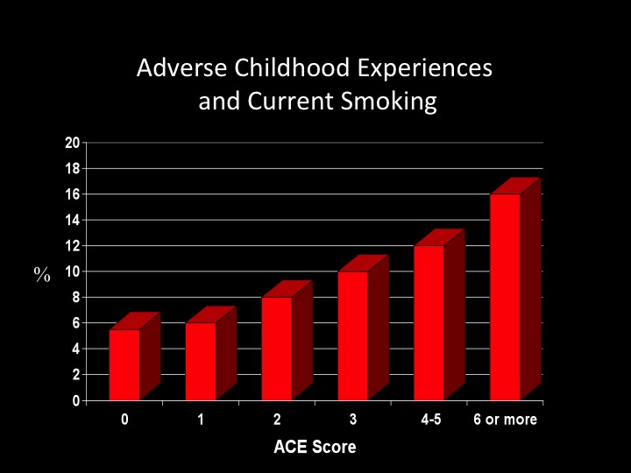
Information from the original ACE Study

Slide 10
Information from the original ACE Study
Slide courtesy of Robert Anda and Vincent Felitti

Slide 11
Information from the original ACE Study

Slide 13
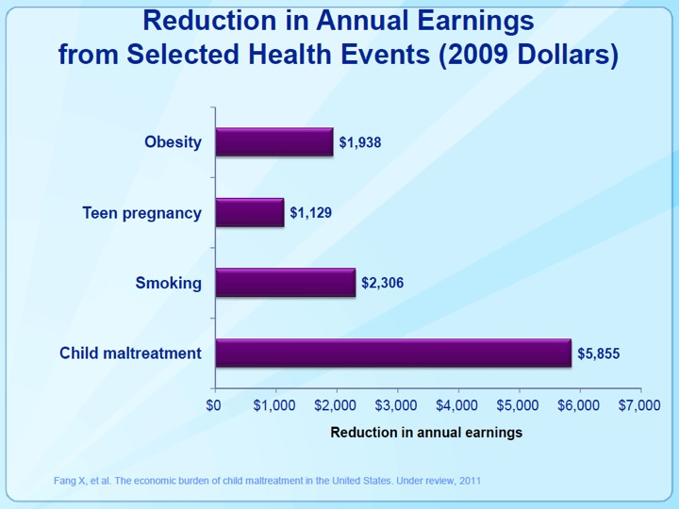

Slide 15
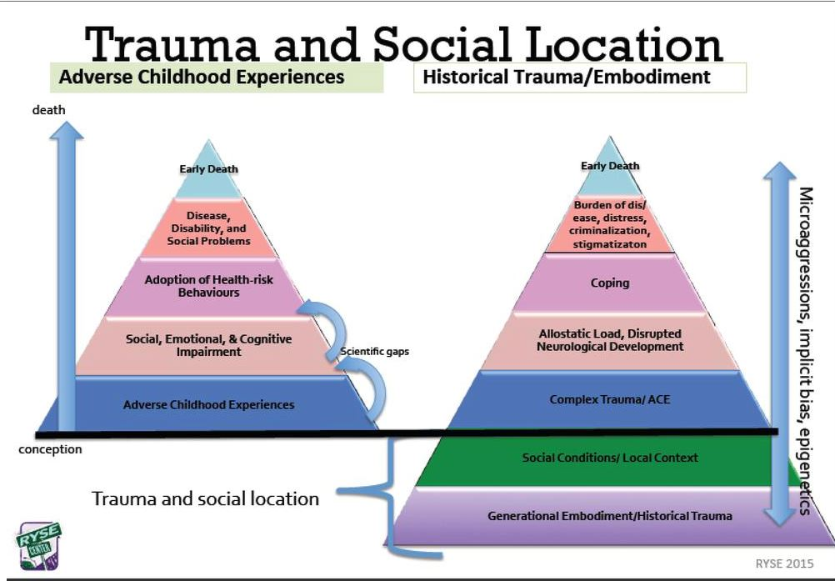

Slide 16
Correlation: Opioid/Heroin Use and ACEs
1998 ACE study Kaiser Permanente and CDC
People with ACE ≥ 3: much greater likelihood of engaging in substance abuse, domestic violence and suicidal attempts, were more likely to be obese, to have dropped out of school, be divorced and to have diabetes, cancer and heart disease. ACE ≥ 6: 4600% more likely to use intravenous drugs relative to ACE of zero.
2016 study
People with ACE ≥ 5, were 3x more likely to misuse prescription pain medication and 5x more likely to engage in injection drug use.
2009 study
over 80% of patients seeking treatment for opioid addiction had at least one form of childhood trauma, with almost 2/3 reporting having witnessed violence in childhood.
Felitti, V.J. (2003) The origins of addiction: Evidence from the Adverse Childhood Experiences study. Praxis der Kinderpsychologie und Kinderspychiatrie, 52, 547 – 559.
Quinn, K., Boone, L., Scheidell, J.D., Mateau-Gelabert, P., Mcgorray, S.Sp., Beharie, N.,Cottler, L.B, and Kahn, M.R (2016) The relationship of childhood trauma and adult prescription pain reliever misuse and injection drug use. Drug and Alcohol Dependence, 169, 190-198.
Sansone, R.A., Whitecar, P., and Wiederman, M.W. (2009) The prevalence of childhood trauma among those seeking buprenorphine treatment. Journal of Addictive Diseases, 28(1), 64-67.

Slide 17
Important Points
Relevance of ACEs to public health problems. What this means and what it doesn’t mean.
Think of ACE score the social equivalent of cholesterol level
Drug and alcohol use can happen in families with an ACE score of zero.
We do not want people to blame or shame parents for these issues.
On a population level, there is a clear correlation and biological connection between ACEs and health outcomes in adults.

Slide 18
Results from the KCHD
Informal Survey
3
Respondents: N= 506
Female 76%
Male 24%
White 95%
African American 1.6%
Native American 1.4%
Asian/PI 1.2%
4
10
2
46
6
5
3
3
7
6
4
4
2
2
35
3
25
252
3
3
3
5
5
3
2
4
2
Other states:
KY, TN, OH, VA, CA, MI

Slide 19
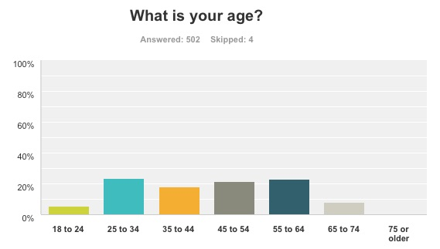

Slide 20
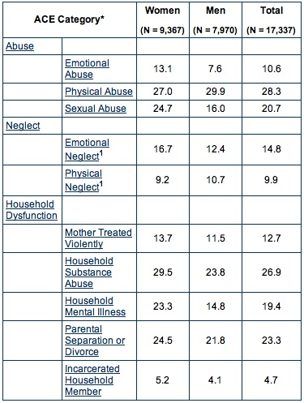
KCHD
N = 506
Comparison between
the original ACE study
and our survey results
36
22
22
30
11
13
30
36
30
5
http://www.cdc.gov/nccdphp/ACE/index.htm

Slide 21
Summary statistics from ACE
KCHD
27.8
18.5
12.4
13.1
28.2
72% of patients reported at least one ACE event
Over 1 in 4 patients had a score of 4 or more
ACEs are extremely common and relevant to the public health problems

Slide 23
KCHD Survey
Distributed via press (newspaper, television, radio, web) and e-mail.
Conducted via web-based tool from November 12-28, 2015.
Purpose: to open a discussion on the role of adverse childhood experiences (ACEs) on our major public health problems through a snapshot survey. Not intended to be a full community cross-section.

Slide 24
What to do about ACEs
Acknowledge the problem exists and ask the questions
Educate the public and decision-makers
Identify at-risk families
Primary prevention programs to treat traumatized people before they become parents and break the intergenerational cycle at the maternal-paternal-child level
Teach better parenting skills
Acknowledge successful programs.

Slide 26
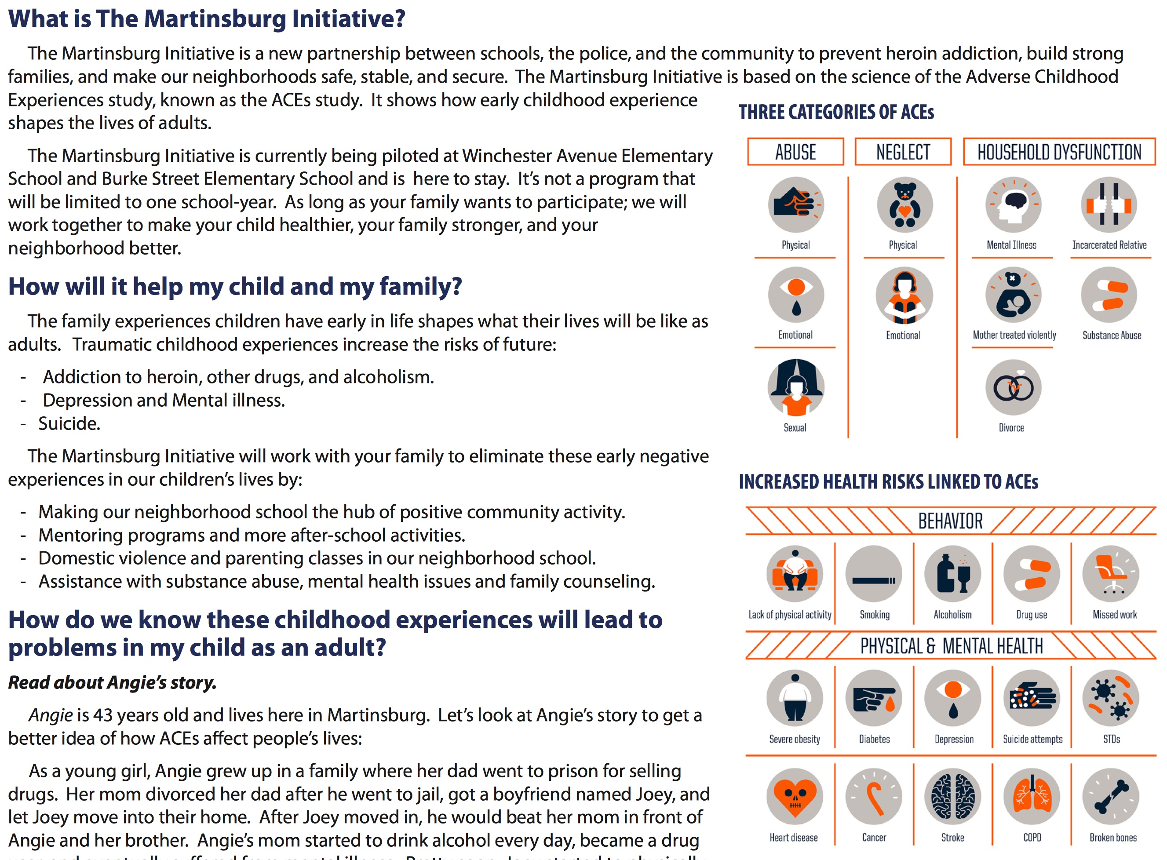

Slide 27
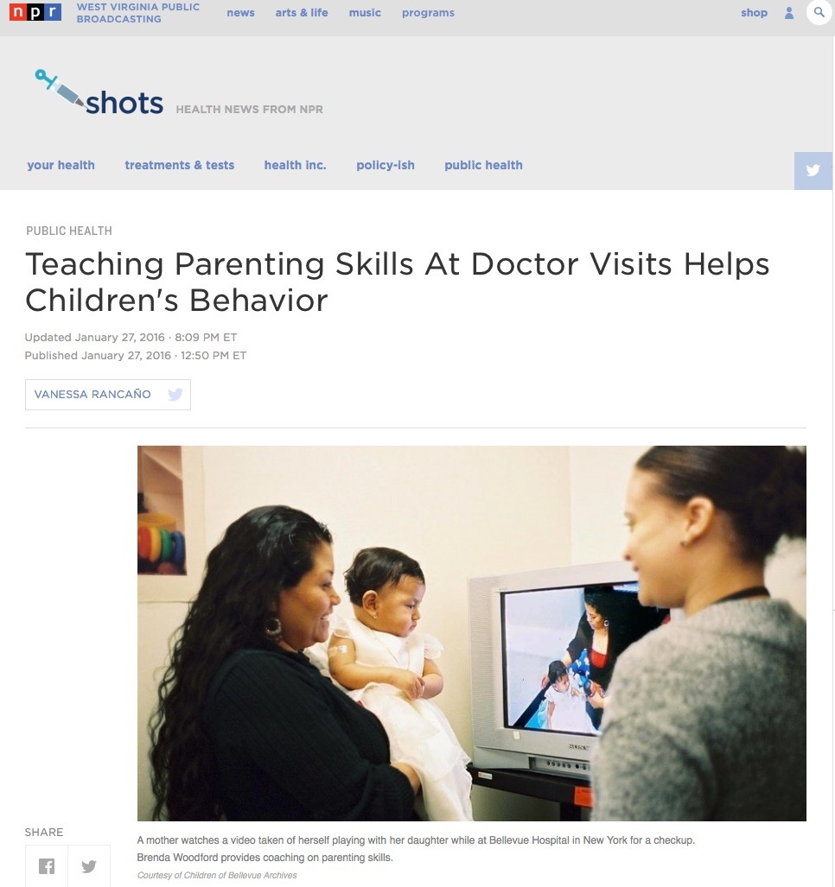
Primary Care Prevention Model
Primary Prevention
Raising awareness
Trauma-informed community
Promoting healthy parenting
Secondary Prevention
Routine screening
Best done in privacy of home
Inert vehicle for questionnaire
Reducing burden of ACEs
Teaching self-care techniques
Tertiary Prevention
Home visitation
Mental health referral
Social Work referral
Intergenerational interventions
Based on Dr. Nadine Burke-Harris, The Center for Youth Wellness, October 23, 2015

Slide 28
Primary Care Recognition
Screen for ACEs
Counsel patients if adults
“How do you think this might have affected you in your life?”
Listen. Be present.
Advise ACEs are common. Change the question from “What’s wrong with you?” to “What happened to you?”
A high ACE score is not a reason to refer to mental health in the absence of other mental health issues.
Try not to “medicalize” the social history, but to connect past with present
Age-appropriate counseling for children and counseling for parents
Avoid shaming as much as possible.
“People do the best they can with what they know until they know something better.” - Dr. Vincent Felitti
Refer in the presence of other physical or psychological illness as appropriate
Based on Dr. Nadine Burke-Harris, The Center for Youth Wellness, October 23, 2015

Slide 29
Signs and Symptoms of ACEs in Children
Sleep disturbances
Weight gain or loss
Enuresis or encopresis
Constipation
Hair loss
Developmental regression
School failure or absenteeism
Failure to thrive
Poor control of chronic diseases (asthma, diabetes)
Aggression
Poor impulse control
Frequent crying
Restricted affect or numbing
High risk behavior in adolescents
Unexplained somatic complaints
Based on Dr. Nadine Burke-Harris, The Center for Youth Wellness, October 23, 2015

Slide 30
Dr. Nadine Burke-Harris, The Center for Youth Wellness, October 23, 2015

Slide 31
Sample Scripts
“We now understand exposure to stressful or traumatic experiences like the ones listed here may increase the amount of stress hormones that a child's body makes and this can increase their risk for health and developmental problems like asthma and learning difficulties.
Because of what your child has experienced, I am concerned this may be contributing to her problems in school/worsening asthma/weight gain (fill in the blank).
Some of the things shown to help the body recover from adversity and normalize the stress hormones include good nutrition, healthy sleep, regular exercise, mental health, mindfulness-like meditation, and healthy relationships.
I’d like to refer your child to some services that could be helpful.”
Dr. Nadine Burke-Harris, The Center for Youth Wellness, October 23, 2015

Slide 32
Sample Script
“We also know that a healthy caregiver is one of the most important ingredients for healthy children so the same applies to you mom/dad/grandma/auntie. Reducing our managing your stress level is one of the best things that you can do for your child to improve his/her health and development.”
Dr. Nadine Burke-Harris, The Center for Youth Wellness, October 23, 2015

Slide 33
Non-pharmacologic practices:
Children and Adults
Exercise
Regulation of HR and BP
Regulation of the hypothalamic-pituitary axis (HPA)
Decrease depression and anxiety
Regulation of cerebral neurotransmitters including dopamine and serotonin
Endorphin release
Mindfulness-based awareness training
Regulation of HR, BP, and HPA
Anti-inflammatory effects
Decreases depression and anxiety
Decrease post-traumatic symptoms
Dr. Nadine Burke-Harris, The Center for Youth Wellness, October 23, 2015

Slide 34
Bottom lines
ACEs are common and relevant to primary care practices, but completely overlooked.
Biological,neurobiological,neuroendocrine, and cellular mechanisms all at play in causing illness
Shifting the dialogue from “What’s wrong with me?” to “What happened to me?”
Asking sensitive questions is best done through an inert mechanism in privacy prior to the visit.
Shifting our own perspective from judgment to compassion.
Try to avoid medicalizing ACEs- most people have the capacity to grow- it just needs time and cultivation of those internal resources: exercise and mindfulness/yoga.
Some people will need referral for mental health reasons.
The healing is in the hearing. We just need to listen.
Addressing ACEs in practice can lead to fewer diagnostic tests and fewer medications.
Dr. Nadine Burke-Harris, The Center for Youth Wellness, October 23, 2015

