Slide 1
School Counseling Update
Barbara Brady, PhD
School Counseling Coordinator
Office of Instruction

Slide 2
School Counselor Performance Standards
  1. Program Planning, Design and Management
  2. Program Delivery
  3. Data Driven Accountability and Program Evaluation
  4. Leadership and Advocacy, and
  5. Professional Growth and Responsibilities.
Key words (examples)
Ensures broad stakeholder input in planning and delivering program
Partners with community stakeholders to support student learning and well being.
Provides access to early and ongoing interventions for at-risk students.
Maintains a structured process for early identification of at-risk behaviors and student referrals.

Slide 3
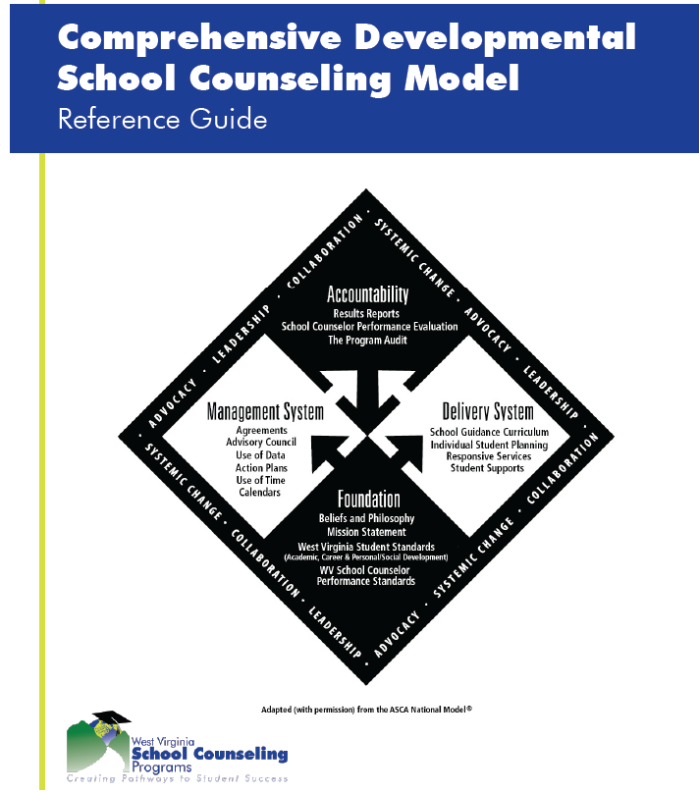
NEW
2012

Slide 4
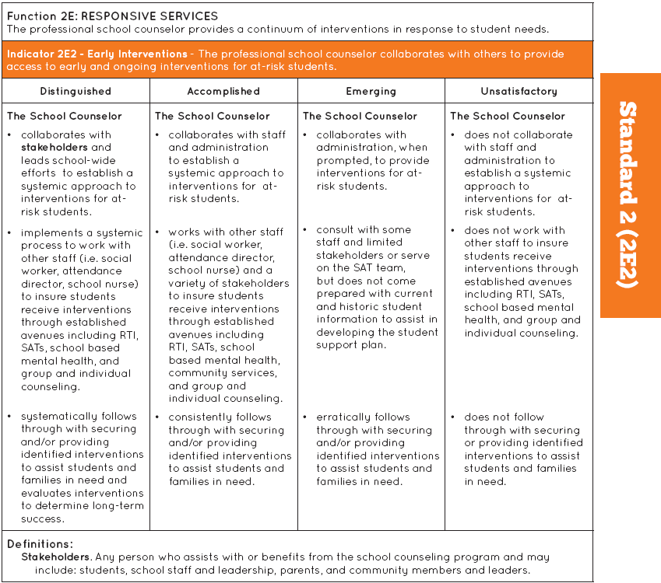
SAMPLE RUBRIC

Slide 5
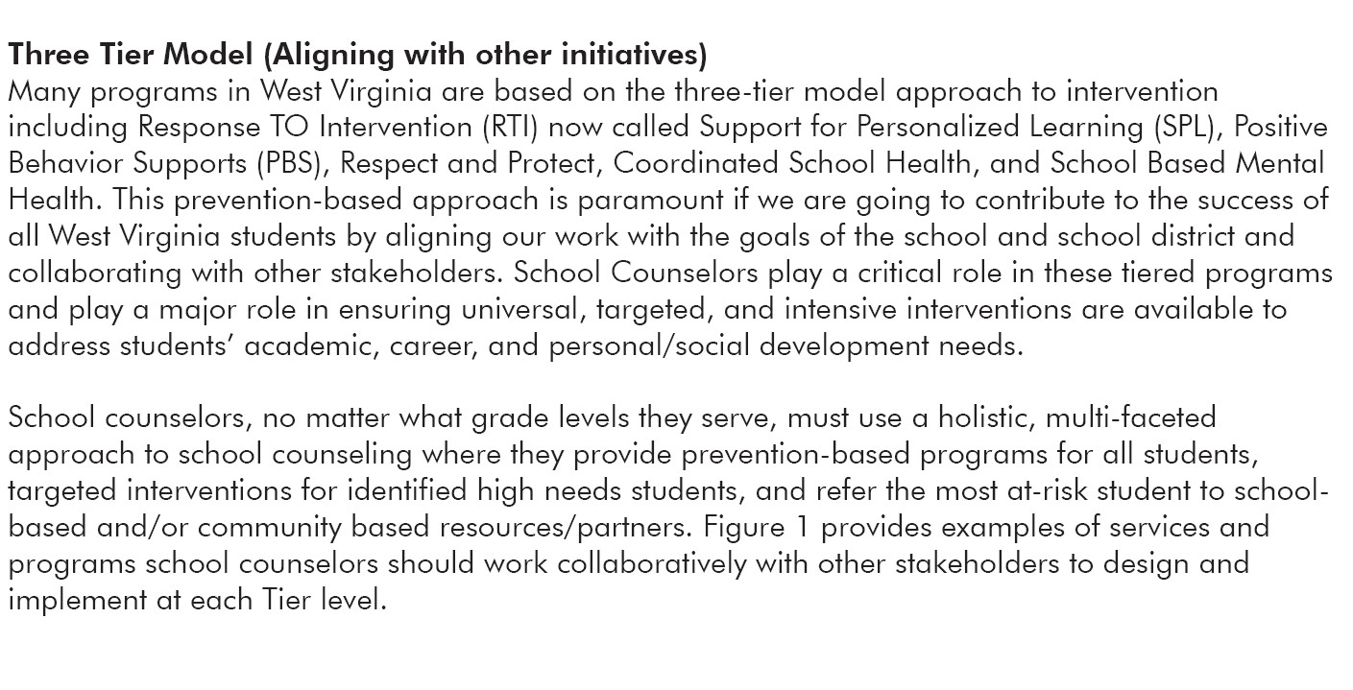
3-Tier Language from Model

Slide 6
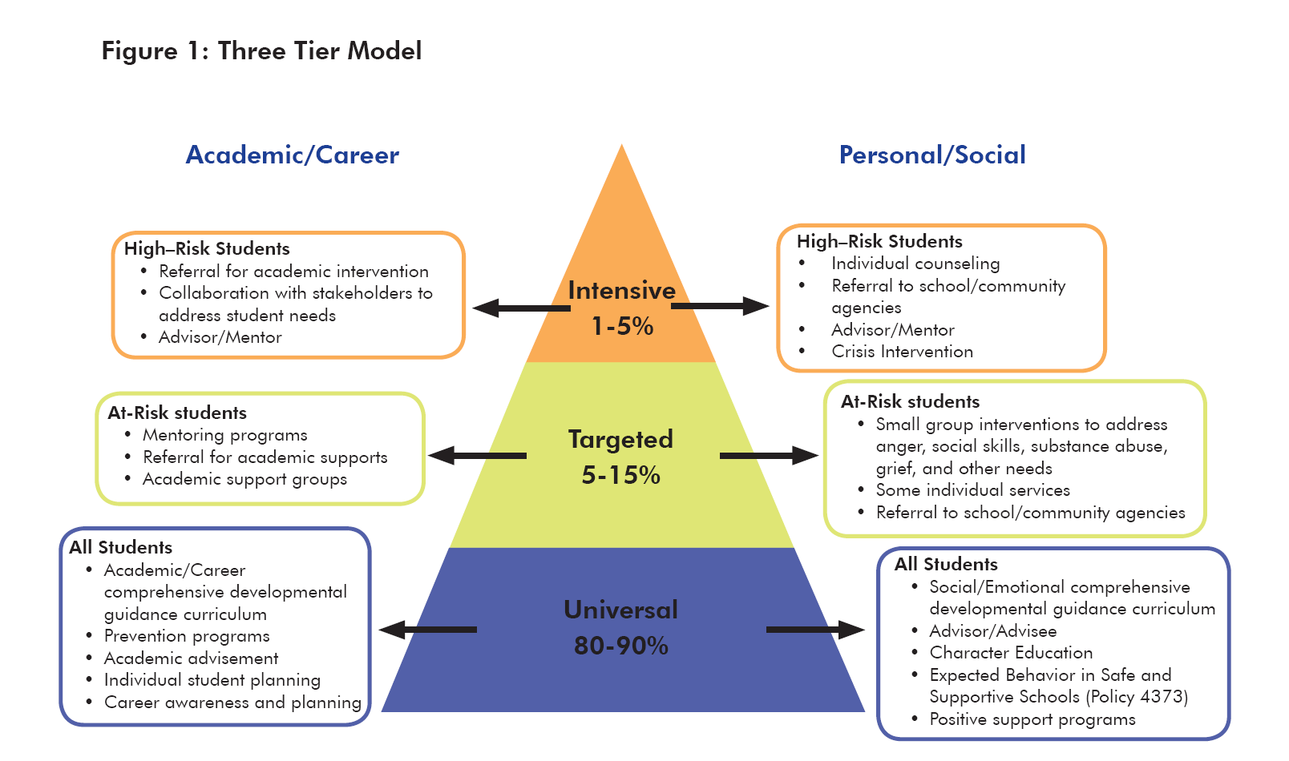

Slide 7

School Counseling Protocols
http://wvde.state.wv.us/counselors/protocols.html
  Best Practice Guides for School Counselors
  Developed by WV Counselors and field experts
  Defines roles and responsibilities for programmatic levels
  Provides related resources in a single guide
  Ongoing development
  Easily assessible

Slide 8
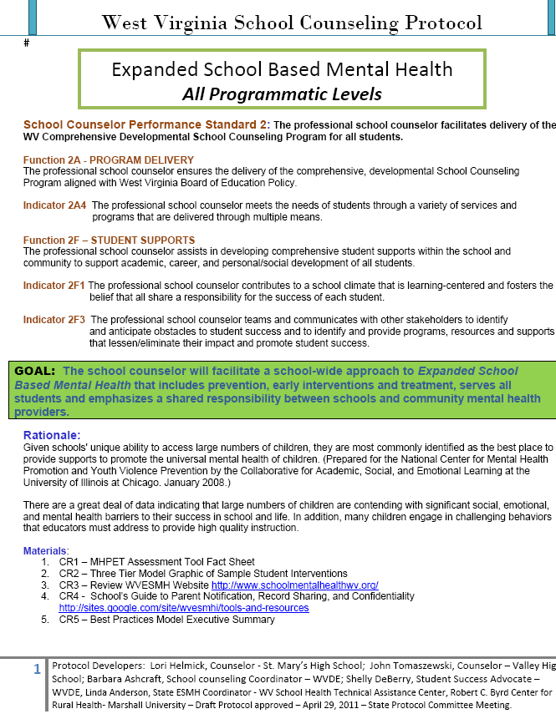

Slide 9
New Evaluation System
13 EVALUATION ELEMENTS
Piloted in 9 schools (all programmatic levels) 2011-12
Implemented in 125 Demonstration Sites 2012-13
Going statewide 2013-14

Slide 10
New Evaluation System
Self Reflection
Annual goals
Counselor driven
Evidence based
All counselors/educators evaluated annually
Support Plans
Goal… all counselors
performing at ACCOMPLISHED

Slide 11
Policy 2315 Revision
Moving from counselor/student focus to….
  Student/Program Focused
  Role of Counselor defined in…
    2010 School Counselor Performance Standards
    2012 School Counselor Model

Slide 12

NEW Standards
[School Counseling Program]
Student Success and Career Readiness Standards
Integrated into all aspects
of the educational program
including all curricular areas
Collaboratively delivered
Three programmatic
levels

Slide 13
NEW Student Standards
[School Counseling Program]
Will be called…
Student Success and Career Readiness Standards
Academic/Learning
Development
Career Development/
Life Planning
Global Citizenship (new)

Slide 14

School-wide Guidance and Advisement http://wvde.state.wv.us/counselors/links/about.html
Comprehensive teacher-led, student-centered advising program for students in grades 5-12 (school success, career exploration & planning and personal/social development)
Organized structure for:
  Mentoring
  Consistent delivery of academic, career, and personal/social
  standards
  Connecting students with a caring adult
  Increased collaboration between stakeholders
  40 lesson plans per grade level ( 9-12)
  36 lesson plans per grade level ( 5-8)
  Offered for credit
  Online framework and implementation tools
http://wvde.state.wv.us/counselors/links/about.html

Slide 15
NEW Online Courses… coming soon
1. Implementing the State Model
2. Operationalizing the new student
standards

