Slide 1
West Virginia Performance Effectiveness Review Tool
& Benchmarks
August 9, 2011
Back to School Workshop
Notes:
Welcome
Thank you for all the hard work you do!
We are excited that the focus of the 2010 BTS Workshop is the WV PERT and clinical quality benchmarks.
Today’s focus is SBHCs “Shine and Sharing” with each other. The focus is benchmarks. Hope you enjoy, consider “Shining and Sharing”.

Slide 2
1998 - Guidelines for WV School Based Health Centers were adopted. 2003 - Guidelines were revised as Principals, Standards and Guidelines for School-Based Health Centers in West Virginia 2004 - WV PERT was implemented. 2009 - Guidelines were revised as Standards and Guidelines for School-Based Health Centers in West Virginia. WV PERT updated to reflect new Standards and Guidelines, NASBHC’s PMI and National Clinical Quality Indicators 2010 – Quality benchmarks / chart audits in electronic format and oral health added to SCORE model
HISTORY
Notes:
How many people here worked in SBH when the original PERT was introduced?
How many new folks do we have?

Slide 3
WHO
The West Virginia Bureau for Public Health, Division of Primary Care and West Virginia School-Based Health Assembly (made up of SBHC representatives from across the state) previously adopted the West Virginia Performance Effectiveness Review Tool for SBHC in West Virginia.
Notes:
If there are very many new people we will need to explain the role of DPC, SBHA & MU

Slide 4
WHAT
WV PERT is an acronym (West Virginia Performance Effectiveness Review Tool)
Method by which the Division of Primary Care determines staff of the SBHCs have a thorough understanding of the Standards and Guidelines for SBHCs in West Virginia

Slide 5
PURPOSE
Assures that quality medical, psychosocial and educational health services are delivered in accordance with current best practices
Confirms that state funds are being used effectively and efficiently
Notes:
This is a tool for you to use to help you with continually improving. The process is NOT punatitive.

Slide 6
GOALS
To improve access for West Virginia’s students to primary health services
To meet the physical and emotional health needs of students at their school site

Slide 7
PARTICIPATION
All SBHC’s receiving funding from the WV Bureau for Public Health/Division of Primary Care will participate in the statewide evaluation program.
The sponsoring organization must:
Be knowledgeable of Standards and Guidelines established by the DPC in conjunction with the School Based Health Assembly
Complete an annual self-evaluation
Be available for a site visit by DPC staff every three years
Notes:
Most all SBHC participate regardless of their funding sources.

Slide 8
IMPLEMENTATION
In 2004 each SBHC performed first annual self-evaluation using WV PERT.
In 2010 each SBHC performed first electronic audit and clinical quality benchmarks added
Expect:
Follow up site visits to the SBHC to observe, measure and validate the information provided by the WV PERT self-evaluation.
Feedback and a “Certificate of Compliance”

Slide 9
WV PERT
Chart Audits: General, Billing & Coding and Benchmark
Score Model
Site Visits

Slide 10
SCORE MODEL
Facilities (FAC)
Business Operations (BO)
Care Management(CM)
Human Resources (HR)
Compliance (COM)
Behavioral Health (BH)
Oral Health (OH)

Slide 11
West Virginia School-Based Health Centers are doing an excellent job!

Slide 12
Feedback/Discussion
Many sites are doing really well on the SCORE model
If the DPC were to offer exemption, what percentage of score would be a reasonable cut off point?

Slide 13
BENCH MARKS FOR WV PERT
General Chart Audit – required annually
Billing & Coding – required annually
3. Pick one (1) benchmark:
Physical Examinations are Comprehensive
Up to Date Adolescent Immunizations
Yearly Blood Pressure, Height, Weight, and BMI
Type 2 Diabetes Screening
Written Asthma Action Plan
Behavioral Health: Poor School Performance & Depression
Oral Health
Please be certain to put the name of the SBHC on each from and electronic signature of individual(s) completing the forms

Slide 14
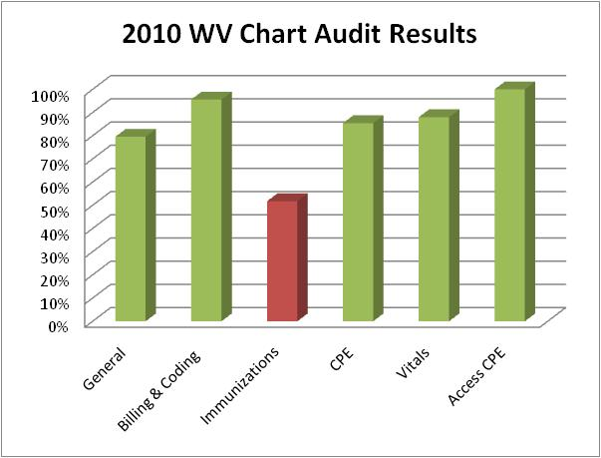

Slide 15
IMMUNIZATIONS:
What resources are needed to assist with improving immunization rates among adolescents?
Developing SBHC partnerships – CSPHP, WIN, Center for Rural Health Development and others?
Notes:
It is exciting to see many SBHC focusing on CPE and Immunizations. The WV Immunization is a wonderful resource.
Take Your Best Shot Request for Proposals and Grant Application for Phase Four is now open. If you or a county that you know of would be interested, visit the WIN website under Take Your Best Shot www.immunizenow.org.
Marshall University has tools available on the WVSBHA website under the MU technical assistance tab

Slide 16
COMPREHENSIVE PHYSICAL EXAMS:
What resources are needed to assist with improving CPE?
Vision and Hearing Screening
Notes:
It is exciting to see many SBHC focusing on CPE and Immunizations. The WV Immunization is a wonderful resource.
Take Your Best Shot Request for Proposals and Grant Application for Phase Four is now open. If you or a county that you know of would be interested, visit the WIN website under Take Your Best Shot www.immunizenow.org.
Marshall University has tools available on the WVSBHA website under the MU technical assistance tab

Slide 17
POLL
We would like your feedback on what time frame works best for SBHCs to complete the WV PERT and who should receive notification and instructions for WV PERT?
April with state grant application
May (state grant due this month)
June
July
Other

Slide 18
SITE VISITS
Description of what a site visit entails
Will visit one SBHC site per sponsoring agency in 2011-12
Write your sponsoring agency, month you prefer a site visit, a specific date or day if you have a preference on the handout provided.
If unknown, just write “please follow up” with which individual to be contacted

Slide 19
OPPORTUNITY FOR FEEDBACK
On your 3x5 card please provide us with feedback such as:
How have you/your students benefited?
Suggestions for improvement?
Difficulties encountered?
Anything else you would like to share

Slide 20
TECHNICAL ASSISTANCE
The Division of Primary Care in conjunction with Marshall University Technical Assistance and Evaluation Center are available to provide technical assistance.

Slide 21
Questions / Assistance
WVDHHR/ OCHS & HP – Division of Primary Care
Nell Phillips, RN, MSM/HCA - nell.h.phillips@wv.gov
Joan Skaggs, RN, MSN - joan.d.skaggs@wv.gov
Phone: 304-558-4007
Marshall University – Technical Assistance
Paula Fields, RN, MSN - pfields4@yahoo.com
Phone: 304-846-9739

